Slide 1
THE RUTHERFORD-SANTILLI
NEUTRON MODEL
Conceptual Aspects and Experimental Verification of
the Rutherford-Santilli Neutron Model
ICNAAM 2013
Chandrakant S. Burande
Vilasrao Deshmukh College of Engineering & Technology, Mouda
India
Email: csburande@gmail.com
Neutron Synthesis

Slide 2
THE RUTHERFORD-SANTILLI
NEUTRON MODEL
ACKNOWLEDGEMENTS
The author is highly grateful to Professor R. M. Santilli, Prof. Anderson and Prof. C. Corda for giving an opportunity to present this paper in ICNAAM-2013.
The financial support from the R. M. Santilli Foundation is gratefully acknowledged.
The author is also highly indebted to Prof. R. M. Santilli and Professor A. A. Bhalekar for suggesting me this topic and helping me in writing this paper by their valuable advices and suggestions in its overall improvement.
Neutron Synthesis
Chandrakant S. Burande, VDCET, Mouda, India

Slide 3
THE RUTHERFORD-SANTILLI
NEUTRON MODEL
Contents
Rutherford’s Conjecture
Neutrino Hypothesis
Neutrino Controversies
Hadronic Mechanics
Neutron Spin
Neutron Magnetic Moment
Neutron Synthesis
Chandrakant S. Burande, VDCET, Mouda, India

Slide 4
THE RUTHERFORD-SANTILLI
NEUTRON MODEL
Rutherford’s Conjecture
Rutherford’s Conjecture
In 1920 H. Rutherford [1] conjectured that neutron is a compressed hydrogen atom in the core of the stars and claimed that first particle synthesized in stars is neutron from a proton and an electron after which all known matter is progressively synthesized. Accordingly,
In 1932, the existence of the neutron
was confirmed by Chadwick [2].
QE
[1] H. Rutherford, Proc. Roy. Soc. A, Vol. 97, 374 (1920).
[2] J. Chadwick, Proc. Roy. Soc. A, Vol. 136, 692 (1932).
Neutron Synthesis
Chandrakant S. Burande, VDCET, Mouda, India

Slide 5
THE RUTHERFORD-SANTILLI
NEUTRON MODEL
Neutrino Hypothesis
Pauli’s Objection
Pauli [3] noted that the spin 1/2 of the neutron cannot be represented via a quantum state of proton and electron, each having spin 1/2.
Fermi’s Proposal
In order resolve Pauli's objection, Fermi [4] developed the theory of weak interactions and proposed the emission of a neutral and massless particle, named neutrino.
[3] W. Pauli, Handbuch der Physik, Vol. 24, Berlin, Springer Verlag, 1933.
[4] E. Fermi, Nuclear Physics, Chicago, University of Chicago Press, 1949.
Neutron Synthesis
Chandrakant S. Burande, VDCET, Mouda, India

Slide 6
THE RUTHERFORD-SANTILLI
NEUTRON MODEL
Santilli’s Observations
Neutrino Controversies
However, Santilli [5] has dismissed the Fermi’s version of synthesis of neutron on following reasons:
The sum of the rest energies of the proton and of the electron, is smaller than the rest energy of the neutron by margin of 0.782 Mev.
Antineutrino cannot deliver the 0.782 MeV needed for the neutron synthesis because the cross section of former with electron or proton is null.
Till date, proton and electron are the only experimentally discovered stable massive particles. Hence, emission of neutrino in neutron formation is irrelevant, it cannot be directly detected.
[5] R. M. Santilli, Hadronic Mathematics, Mechanics and Chemistry, Volume I-V, Palm Harbor, U.S.A., International Academic Press, 2008.
Neutron Synthesis
Chandrakant S. Burande, VDCET, Mouda, India

Slide 7
THE RUTHERFORD-SANTILLI
NEUTRON MODEL
Limitation of QM
limitation of QM
Schrödinger equation
does not admit positive binding energy for quantum bound states when electron totally immersed within the hyper-dense medium inside the proton structure at distances of the order 10⁻¹³ cm. For example mass defect in nuclear fusion.
Quantum Mechanics bound state of p & e is the hydrogen atom, with smallest orbit of the order of 10⁻⁸ cm (Bohr orbit).
Santilli ‘s hadronic mechanics has identified the bound state when the electron orbits within the proton structure at distances of the order of or less 10⁻¹³ cm.
The mutual overlapping of the charge distribution or wavepackets of electron and proton leads new interactions of contact type. In this situation quantum mechanics fails to represent nonlocal integral interactions and Non- Hamiltonian Potential.
Neutron Synthesis
Chandrakant S. Burande, VDCET, Mouda, India

Slide 8
THE RUTHERFORD-SANTILLI
NEUTRON MODEL
Hadronic State
Quantum Mechanics
Bound state
10⁻⁸ cm
10⁻¹³ cm
Bound state identified by
Hadronic Mechanics
Mutual
Distance
Energy
Level
The conventional quantum state is recovered when the electron leaves the proton structure . Thus hadronic state is one and only one, the neutron. Hence, energy levels of the hydrogen atom are the excited states of the neutron.
Neutron Synthesis
Chandrakant S. Burande, VDCET, Mouda, India

Slide 9
THE RUTHERFORD-SANTILLI
NEUTRON MODEL
Hadronic Energy
Hadronic Mechanics
In this event, Santilli isomechanics is ideally suited for a quantitative study of the neutron synthesis because, in addition to all interactions characterizing the hydrogen atom, allows the new interactions caused by deep mutual penetration of the constituents.
The method has been used by Santilli in numerous applications. Santilli [6] obtained an isoequation for the neutron by isotopically lifting of Schrödinger equation introducing additional potential term of Coulomb nature that reads as,
with isounit
[6] R. M. Santilli, “Apparent Consistency of Rutherford’s Hypothesis on Neutron as a Compressed Hydrogen Atom”, Hadronic J. Vol. 13, 513-531 (1990).
Neutron Synthesis
Chandrakant S. Burande, VDCET, Mouda, India

Slide 10
THE RUTHERFORD-SANTILLI
NEUTRON MODEL
Hadronic Energy
the two diagonal matrices represent the shapes (assumed to be spheroids) and the densities of the particle. considered, while
the last term represents the non-Hamiltonian interactions.
Clearly, this mutual penetration cannot be represented with a Hamiltonian for because it does not hold the nonlocal-differential topology.
However, the same interactions can be readily represented with Santilli’s isounit as it indeed nonlocal-integral.
Neutron Synthesis
Chandrakant S. Burande, VDCET, Mouda, India

Slide 11
THE RUTHERFORD-SANTILLI
NEUTRON MODEL
Hadronic Energy
For spherical point-like charge particle, such as electrons, the diagonal matrices are reduces to 1. The evaluation of the volume integral into a constant,
where P and Q are constants and b is inverse of hadronic horizon, .
Neutron Synthesis
Chandrakant S. Burande, VDCET, Mouda, India

Slide 12
THE RUTHERFORD-SANTILLI
NEUTRON MODEL
Hadronic Energy
The isotopic element now becomes
is the Hulthen potential and is Hulthen's constant. The Hulthen potential at small distances behaves like the Coulomb potential,
Neutron Synthesis
Chandrakant S. Burande, VDCET, Mouda, India

Slide 13
THE RUTHERFORD-SANTILLI
NEUTRON MODEL
Hadronic Energy
Using above equations, Santilli obtained the nonrelativistic radial equation of the hadronic two-body structure model that reads as
where hadronic binding energy.
Assuming the change of variable, the solution of the above equation is given by the Jacobi polynomials,
Neutron Synthesis
Chandrakant S. Burande, VDCET, Mouda, India

Slide 14
THE RUTHERFORD-SANTILLI
NEUTRON MODEL
Hadronic Energy
The hadronic binding energy then acquires the typical spectrum of
Hulthen’s potential
The only admissible states are therefore are those for which,
the santilli-Schrodinger equation gives following isonormalized isoeigen function
An isoparticle to be bounded inside the hadronic horizon, its isowavelength ( ) must be proportional to the horizon itself and this gives
Neutron Synthesis
Chandrakant S. Burande, VDCET, Mouda, India

Slide 15
THE RUTHERFORD-SANTILLI
NEUTRON MODEL
Hadronic Energy
where k₁ is a positive quantity that must be constant for a stationary state. Using above equations, Santilli obtained the following expression for the hadronic total energy of the hadronic bound state,
The total energy of the two-body hadronic bound state depends on two unknown constants, k₁and k₂. To achieve a numerical solution of total energy of hadronic state, Santilli considered the mean life of the hadron,
where α is the fine structure constant and the mean-life is isotopic, that is derived via isotopic methods. The mean-life of hadronic bound state then becomes
Neutron Synthesis
Chandrakant S. Burande, VDCET, Mouda, India

Slide 16
THE RUTHERFORD-SANTILLI
NEUTRON MODEL
Hadronic Energy
Comparing above equations, give
The numerical solution of unknown constants and are obtained by Santilli,
Thus, the hadronic binding energy for admitted level,
is insignificantly small and hence can be neglected.
Neutron Synthesis
Chandrakant S. Burande, VDCET, Mouda, India

Slide 17
THE RUTHERFORD-SANTILLI
NEUTRON MODEL
Hadronic Energy
The hadronic kinetic energy within the hadronic horizon is equally insignificant, that is
In this event, the total hadronic energy of the neutron is primarily characterized by the rest energy of the proton and the isonormalized rest energy of the isoelectron,
is a geometrization of the departure of the interior of hadrons
from our space-time.
Hence, calculated rest energy of isoelectronium is numerically identical to experimentally determined rest energy of neutron.
Neutron Synthesis
Chandrakant S. Burande, VDCET, Mouda, India

Slide 18
THE RUTHERFORD-SANTILLI
NEUTRON MODEL
Neutron Spin
The Neutron Spin
A general law of hadronic mechanics is that only the singlet coupling of spinning particles at mutual distances of the order of 10⁻¹³cm, their size is stable, while triplet couplings are highly unstable (Santilli illustrated this fact with famous Gear Model: Gears can only be coupled in singlet).
Neutron Synthesis
Chandrakant S. Burande, VDCET, Mouda, India

Slide 19
THE RUTHERFORD-SANTILLI
NEUTRON MODEL
Neutron Spin
The Neutron Spin
For parallel spin (triplet state) is discarded by hadronic mechanics at mutual distances of the order of 10⁻¹³cm, are highly unstable (Santilli illustrated this fact with famous Gear Model: Gears can only be coupled in singlet).
Neutron Synthesis
Chandrakant S. Burande, VDCET, Mouda, India

Slide 20
Neutron Spin
THE RUTHERFORD-SANTILLI
NEUTRON MODEL
Neutron Spin
In neutron the spin of the proton is equal but opposite to that of the electron spin. Thus, the resulting spin is zero for singlet state. However, observed spin of the neutron is ½.
The interpretation of the spin ½ of the neutron was for the first successfully explained by Santilli. Considering the initiation of Rutherford’s process penetration of the electron within hyperdense medium inside the proton.
As soon as the penetration begins, the isoelectron is trapped inside the hyperdense medium inside the proton, thus resulting in a constrained orbital motion of the isoelectron that must coincide with the proton spin.
Under this circumstance, it is then evident that the isoelectron is constrained to have an orbital angular momentum ½, the total angular momentum of the isoelectron is null and the spin of the neutron coincides with that of the proton.
Neutron Synthesis
Chandrakant S. Burande, VDCET, Mouda, India

Slide 21
THE RUTHERFORD-SANTILLI
NEUTRON MODEL
Neutron Spin
Neutron Synthesis
Chandrakant S. Burande, VDCET, Mouda, India

Slide 22
THE RUTHERFORD-SANTILLI
NEUTRON MODEL
Neutron Spin
The actual mathematical representation of the above structure was obtained by Santilli. It requires isotopically lifting of the quantum mechanical spin that, in turn, required the prior isotopic lifting of Lie's theory and its underlying mathematics.
Note that the proton is not mutated because it is 2000 times heavier than the electron, and that the coupling must be in singlet for stability.
This implies that, for the case of the neutron structure, the spin of the electron is also not mutated.
However, the angular momentum of electron is mutated inside the hadronic sphere.
The needed mutation of the quantum into the hadronic angular momentum is trivially given by the nonunitary transforms
Neutron Synthesis
Chandrakant S. Burande, VDCET, Mouda, India

Slide 23
THE RUTHERFORD-SANTILLI
NEUTRON MODEL
Neutron Spin
The mutation is supported by the isotopic invariance of the Hilbert space. Nonunitary lifting of angular momentum, in this case, reads
Santilli applied irregular isorepresentations of Lie-Santilli isoalgebras [7] for the representation of the spin of the neutron. Isorepresentations characterized by nonunitary isounitary transforms for the generators different than those for the product. In this case, Santilli has selected the following two-dimensional irregular isorepresentation of
[7] R. M. Santilli, Lie-admissible Approach to the Hadronic Structure, Volume I: Non-applicability of the Galilei and Einstein Relativities in the series Monographs in Theoretical Physics, Hadronic Press, Palm Harbor, Florida, 1978.
Neutron Synthesis
Chandrakant S. Burande, VDCET, Mouda, India

Slide 24
THE RUTHERFORD-SANTILLI
NEUTRON MODEL
Neutron Spin
Santilli then computed the total angular momentum of the neutron model,
resulting in the values anticipated above, namely:
Hadronic Mechanics
Chandrakant S. Burande, VDCET, Mouda, India

Slide 25
THE RUTHERFORD-SANTILLI
NEUTRON MODEL
Neutron Spin
The Neutron Magnetic Moment
The quantum representation of the anomalous magnetic moment of the neutron, is impossible from known magnetic moments of proton, and electron, because quantum mechanics does not admit an orbital motion of the electron inside the proton. By contrast when the hadronic orbital motion is admitted, the magnetic moment of the neutron is generated by the following three contributions,
From above equations, Santilli derived the desired value
Hadronic Mechanics
Chandrakant S. Burande, VDCET, Mouda, India

Slide 26
THE RUTHERFORD-SANTILLI
NEUTRON MODEL
The Neutron Magnetic Moment
Experimental Verification of
the Rutherford-Santilli Neutron Model
Don Borghi’s experiment on synthesis of neutrons
Santilli experiment on the synthesis of neutrons
Santilli’s Aetherino Hypothesis
The Don Borghi-Santilli Neutroid
Interpretation of Don Borghi-Santilli Experiment
Hadronic Mechanics
Chandrakant S. Burande, VDCET, Mouda, India

Slide 27
THE RUTHERFORD-SANTILLI
NEUTRON MODEL
Don Borghi experiment
on the synthesis of neutrons
Don Borghi’s experiment on synthesis of neutrons
The first experiment on the synthesis of neutrons from protons and electrons was conducted by Carlo Borghi, C. Giori and A. Dall’Olio in the 1960s at the CEN Laboratories in Recife, Brazil [8].
Hydrogen gas at pressure of 1 bar was obtained from the electrolytical separation of water and was placed in the interior of a cylindrical metal chamber.
Hydrogen gas kept ionized by an electric arc with about 500 V and 10 mA.
Suitable materials which are vulnerable to nuclear transmutation when exposed to a neutron flux, were placed exterior of the chamber.
[8] C. Borghi, C. Giori C. and A. Dall’Olio, Communications of
CENUFPE, Number 8 (1969) and 25 (1971).
Hadronic Mechanics
Chandrakant S. Burande, VDCET, Mouda, India

Slide 28
THE RUTHERFORD-SANTILLI
NEUTRON MODEL
Don Borghi experiment
on the synthesis of neutrons
Following exposures of the order of days or weeks, the experimentalists reported nuclear transmutations that were based on the observed neutron count of up to 104 cps.
Don Borghi experiment has been strongly criticized by academia on pure theoretical grounds without the actual repetition of the tests.
Note that experiment makes no claim of direct detection of neutrons, and only claims the detection of clear nuclear transmutations.
To verify the claim of Don Borghi’s experiment, Santilli repeated this experiment in large number of laboratories and institutions the world over.
Hadronic Mechanics
Chandrakant S. Burande, VDCET, Mouda, India

Slide 29
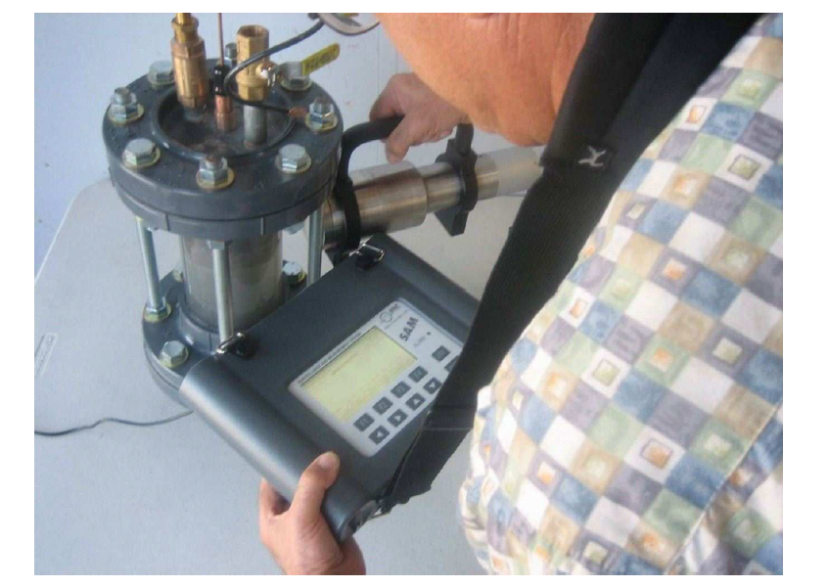
THE RUTHERFORD-SANTILLI
NEUTRON MODEL
Santilli experiment
on the synthesis of neutrons
Santilli experiment on the synthesis of neutrons
Santilli conceived his experiment [9] as being solely based on the use of an electric arc within a cold (i.e., at atmospheric temperature) hydrogen gas without any use of microwave at all.
Hadronic Mechanics
Chandrakant S. Burande, VDCET, Mouda, India

Slide 30
THE RUTHERFORD-SANTILLI
NEUTRON MODEL
Santilli experiment
on the synthesis of neutrons
Three different klystrons were manufactured, tested and used for the measurements. The specifications of detectors were used for measurements are given below:
A detector model PM1703GN manufactured by Polimaster, Inc., with sonic and vibration alarms as well as memory for printouts, with the photon channel activated by CsI and the neutron channel activated by LiI.
A photon-neutron detector SAM 935 manufactured by Berkeley Nucleonics, Inc., with the photon channel activated by NaI and the neutron channel activated by He-3 also equipped with sonic alarm and memory for printouts of all counts. This detector was used to verify the counts from the preceding one.
A BF3 activated neutron detector model 12-4 manufactured by Ludlum Measurements, Inc., without counts memory for printouts. This detector was used to verify the counts by the preceding two detectors.
Electric arcs were powered by welders manufactured by Miller Electric, Inc., including a Syncrowave 300, a Dynasty 200, and a Dynasty 700 capable of delivering an arc in DC or AC mode, the latter having frequencies variable from 20 to 400 Hz.
Hadronic Mechanics
Chandrakant S. Burande, VDCET, Mouda, India

Slide 31
THE RUTHERFORD-SANTILLI
NEUTRON MODEL
Santilli ‘s experiment
on the synthesis of neutrons
Experiment with Klystron-I
Klystron-I was sealed cylindrical of about 6” outside diameter and 12” height, made of commercially available, transparent, Polyvinyl Chloride (PVC) housing along its symmetry axis a pair of tungsten electrodes. The klystron cylindrical wall was transparent so as to allow a visual detection of arc.
After initiation of DC arc there was no detection for hours. However, shaking of klystron the neutrons were detected in a systematic and repetitive way.
The detection was triggered by a neutron-type particle, excluding contributions from photons.
However, these detections were anomalous, that is, they did not appear to be due to a flux of actual neutrons originating from the klystron.
This anomaly is established by the repeated “delayed detections,” that is, exposure of the detector to the klystron with no counts of any type, moving the detector away from the klystron, then seeing the detectors enter into off-scale vibrations and sonic alarms with zero photon counts.
Hadronic Mechanics
Chandrakant S. Burande, VDCET, Mouda, India

Slide 32
THE RUTHERFORD-SANTILLI
NEUTRON MODEL
Santilli ‘s experiment
on the synthesis of neutron
Experiment with Klystron-II
Klystron-II was a rectangular, transparent, made up of PVC of dimension . This klystron was small in size than earlier one to avoid implosion caused by combustion with atmospheric oxygen. This test was conducted only once because of instantaneous off-scale detection of neutrons by all detectors which led to evacuation of the laboratory. Hence, this test was not repeated for safety.
Klystron-III was cylindrical made up of carbon steel pipe with 12” outer diameter, 0.5” wall thickness, 24” length and 3” thick end flanges to sustain hydrogen pressure up to 500 psi with the internal arc between throated tungsten electrodes controlled by outside mechanisms. This test was conceived for the conduction of the test at bigger hydrogen pressure compared to that of Klystron I. The test was conducted only once at 300 psi hydrogen pressures because of instantaneous, off-scale, neutron detections such to cause another evacuation of the laboratory.
Experiment with Klystron-III
Hadronic Mechanics
Chandrakant S. Burande, VDCET, Mouda, India

Slide 33
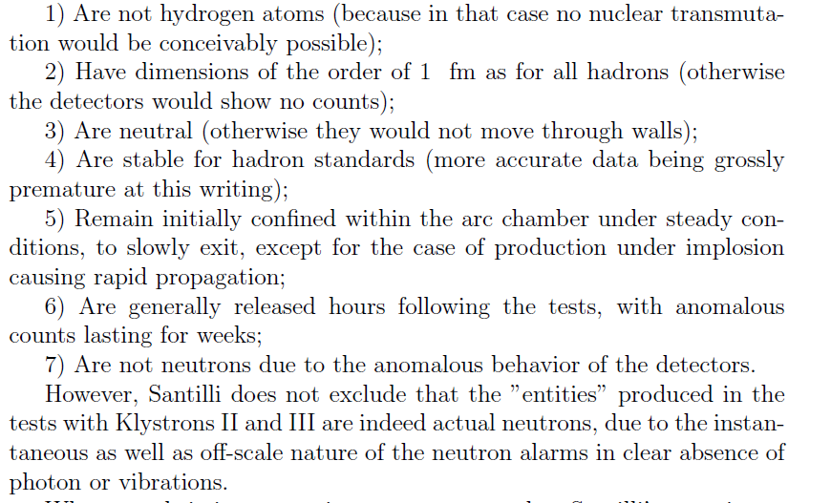
THE RUTHERFORD-SANTILLI
NEUTRON MODEL
Santilli ‘s experiment
on the synthesis of neutron
Conclusion of Experiment
Hadronic Mechanics
Chandrakant S. Burande, VDCET, Mouda, India

Slide 34
THE RUTHERFORD-SANTILLI
NEUTRON MODEL
Santilli’s Aetherino Hypothesis
Santilli’s Aetherino Hypothesis
Santilli replaces the neutrino as a physical particle in our spacetime with a longitudinal impulse originated by the ether as a universal substratum, is called "etherino".
In this view, all physical quantities missing in the neutron synthesis, such as energy and spin, are delivered by said impulse.
A particular motivation for the etherino hypothesis is due to the evident difficulties in accepting that neutrino now believed to have mass could traverse entire planets and stars without appreciable scattering.
However, this difficulty is resolved by the propagation of a longitudinal impulse in the universal substratum because it would underlie matter.
Hadronic Mechanics
Chandrakant S. Burande, VDCET, Mouda, India

Slide 35
THE RUTHERFORD-SANTILLI
NEUTRON MODEL
Santilli’s Aetherino Hypothesis
Santilli’s Aetherino Hypothesis
Additionally, the replacement of the neutrino with the etherino appears to preserve the experimental evidence in the field because what is today detected and interpreted as a "neutrino scattering" could in reality be due to the scattering of the longitudinal impulse with targets.
Hence, the etherino hypothesis appears to resolve some of the insufficiencies of the neutrino conjecture, may eventually resulting to be fully compatible with available experimental data, and is already stimulating rather intriguing research on superluminal communications, that are the only possible for interstellar contact [14] due to evident insufficiencies of electromagnetic waves for galactic distances.
Hadronic Mechanics
Chandrakant S. Burande, VDCET, Mouda, India

Slide 36
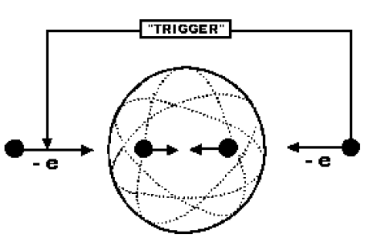
THE RUTHERFORD-SANTILLI
NEUTRON MODEL
The Don Borghi-Santilli
Neutroid
The Don Borghi-Santilli Neutroid
Santilli excludes that the entities produced in the tests with Klystron I are true neutrons for various reasons, such as:
The anomalous behavior of the detector, in the case of the 15 minute delay, self-activated detection indicates first the absorption of ”entities” producing nuclear transmutations that, in turn release ordinary neutrons.
The environment inside stars can indeed provide the missing energy of 0.78 MeV for the neutron synthesis, but the environment inside Klystron I cannot do the same due to the very low density of the hydrogen gas.
Hadronic Mechanics
Chandrakant S. Burande, VDCET, Mouda, India

Slide 37
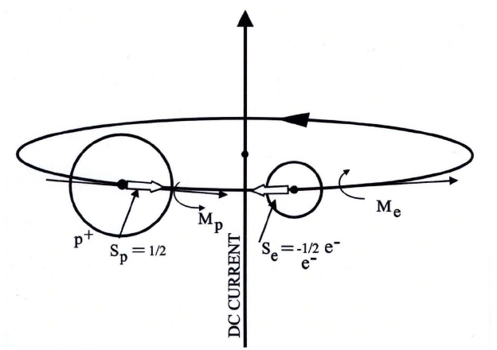
THE RUTHERFORD-SANTILLI
NEUTRON MODEL
The Don Borghi-Santilli
Neutroid
The physical laws of hadronic mechanics do not allow the synthesis of the neutron under the conditions of Klystron- I because of the need of the trigger, namely, an external event permitting the transition from quantum to hadronic conditions.
In fact, the tests with Klystrons-II and III do admit the trigger required by hadronic mechanics. However, Santilli did not discard that the “entities” produced in the tests with Klystrons-II and III are indeed actual neutrons, due to the instantaneous, off-scale nature of the neutron alarms in clear absence of photon or vibrations.
Hadronic Mechanics
Chandrakant S. Burande, VDCET, Mouda, India

Slide 38
THE RUTHERFORD-SANTILLI
NEUTRON MODEL
The Don Borghi-Santilli
Neutroid
In view of above reasons, Don Borghi submitted the hypothesis that the ”entities” are neutron-type particles called “neutroids”.
Santilli adopted this hypothesis and presented the first technical characterization of neutroids and the characteristics in conventional nuclear units, .
Hence, Santilli assumed that in Klystron-I, he produced the following reaction precisely along Rutherford’s original conception
where the value is used for the primary purpose of avoiding the spin anomaly in the neutron synthesis as indicated above and the rest energy of the neutroids is assumed as being that of the hydrogen atom.
Hadronic Mechanics
Chandrakant S. Burande, VDCET, Mouda, India

Slide 39
THE RUTHERFORD-SANTILLI
NEUTRON MODEL
Interpretation of
Don Borghi-Santilli Experiment
Interpretation of Don Borghi and Santilli experiments
In Don Borghi’s and Santilli’s experiments the various substances placed in the exterior of the klystrons did indeed experience nuclear transmutations. If we discard the Don Borghi’s klystron and Santilli’s Klystron-I to produce actual neutrons, then the main question arises from where the neutrons originated and detected.
Evidently, only two possibilities remain, namely, that the detected neutrons were actually synthesized in the walls of the klystrons, or by the activated substances themselves following the absorption of the neutroids produced by the klystrons.
Considering the neutrino hypothesis has no sense for the neutron synthesis for various reasons, Santilli assumes that the energy, spin and magnetic anomalies in the neutron synthesis are accounted for by their transfer either from nuclei or from the aether via his etherino hypothesis
Hadronic Mechanics
Chandrakant S. Burande, VDCET, Mouda, India

Slide 40
THE RUTHERFORD-SANTILLI
NEUTRON MODEL
Interpretation of
Don Borghi-Santilli Experiment
Assuming the binding energy of a neutroid is similar to that of an ordinary nucleon (since neutroids are assumed to be converted into neutrons when inside nuclei, or to decompose into protons and electrons, thus recovering again the nucleon binding energy), Santilli indicates the following possible nuclear reaction for one of the activated substances in Don Borghi’s tests
produces known nuclide, hence it indicates that neutrons were synthesized by the activating substances themselves on absorption of neutroid.
The nuclear reaction with steel wall of the klystron,
yields an unknown nuclide, because the known nuclide is
This indicates that the neutrons in Don Borghi experiment were not synthesized in the walls of his klystron.
Hadronic Mechanics
Chandrakant S. Burande, VDCET, Mouda, India

Slide 41
THE RUTHERFORD-SANTILLI
NEUTRON MODEL
Interpretation of
Don Borghi-Santilli Experiment
Formation neutron via etherino allows an interpretation of some of Santilli detections with the understanding that the anomalous behavior of the detectors, such as the delayed neutron counts, requires special studies and perhaps the existence of some additional event not clearly manifested in Don Borghi’s tests. To initiate the study, Santilli considered the first possible reaction inside the klystron
delivers ordinary deuteron on coupling of hydrogen atom and neutroid. This indicates neutrons cannot be originated inside the klystron-I. Next, Santilli considered following nuclear reactions with the polycarbonate of Klystron-I wall containing about 75% carbon and 18.9% oxygen
Hadronic Mechanics
Chandrakant S. Burande, VDCET, Mouda, India

Slide 42
THE RUTHERFORD-SANTILLI
NEUTRON MODEL
Interpretation of
Don Borghi-Santilli Experiment
Do not give conventional activation processes. Thus, in Santilli’s experiment too, it does not appear that the detected neutrons are synthesized by the walls of klystron. The above analysis leaves as the only residual possibility that in Santilli tests, the neutrons are synthesized by the detectors themselves. To study this possibility, Santilli considered the reaction for Li-activated detectors,
that behaves fully equivalent to detection of neutriods or neutrons. This indicated neutrons detected in Santilli experiment were synthesized by the substance used for detection after absorption of neutriods.
Hadronic Mechanics
Chandrakant S. Burande, VDCET, Mouda, India

Slide 43
THE RUTHERFORD-SANTILLI
NEUTRON MODEL
Concluding Remarks
Concluding Remarks
It is observed that Santilli’s novel discovery of hadronic mechanics appropriately explains the Rutherford’s conjecture on neutron as a compressed hydrogen atom.
He evidently dismissed the neutrino hypothesis and resolved the anomalies pertaining binding energy, spin and magnetic moment without any theological assumption that the proton and the electron "disappear" at the time of the synthesis.
It should also be stressed that the representation is invariant, due to the isounitary character of the model, namely, the numerical values remain the same under the same basic assumptions at different times.
Hadronic Mechanics
Chandrakant S. Burande, VDCET, Mouda, India

Slide 44
THE RUTHERFORD-SANTILLI
NEUTRON MODEL
Concluding Remarks
He verified Rutherford conjecture of neutron synthesis by re-executing Don Borghi’s experiment.
He never ruled out that the detected entities in are only neutrons.
He proposed that the emission of neutron like particle, named “neutriod” due to absence of required trigger.
He also interpreted the possible nuclear reactions by activated substances after absorption of neutriods.
He concluded that evidently the neutrons detected in Don Borghi experiment were synthesized by the nuclei of the activated substances, while the neutrons of Santilli experiment were synthesized by the detectors themselves by their activating substance after absorption of neutriods.
Hadronic Mechanics
Chandrakant S. Burande, VDCET, Mouda, India

Slide 45
Thank You
…………..for patience
Concluding Remarks

