Slide 5
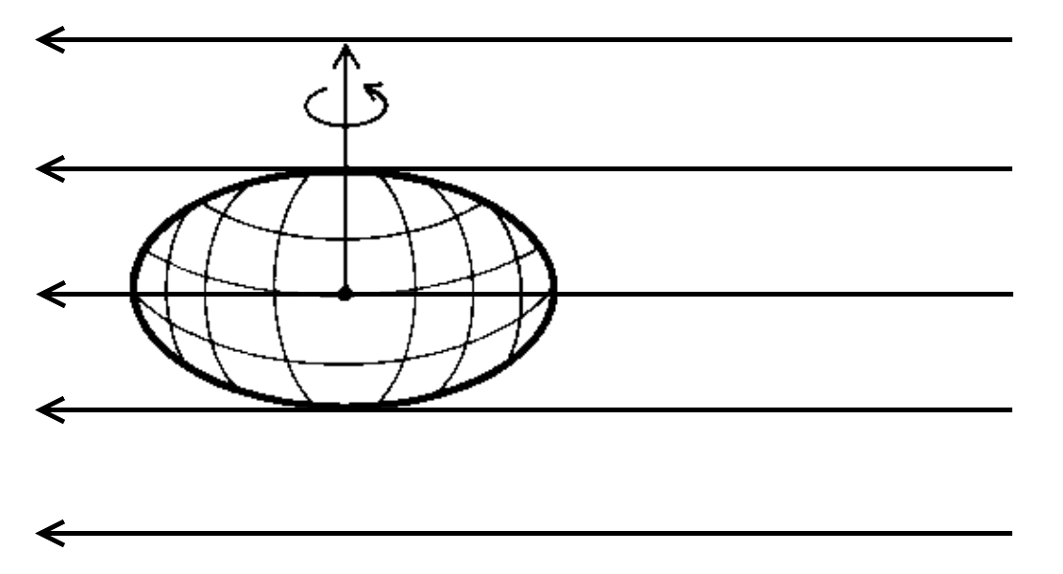

Slide 23
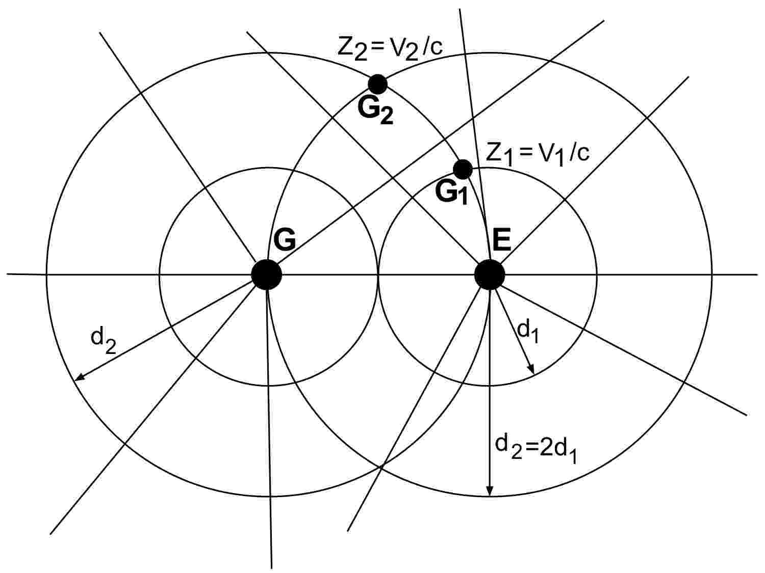
Catastrophic geometric inconsistencies of the expansion of the universe persisting under the hyperbolic expansion opf space itself

Slide 24
The redness of the Sun at Sunset is experimental evidence that the universe is not expanding as well as that the expansion is not accelerating

