Slide 5
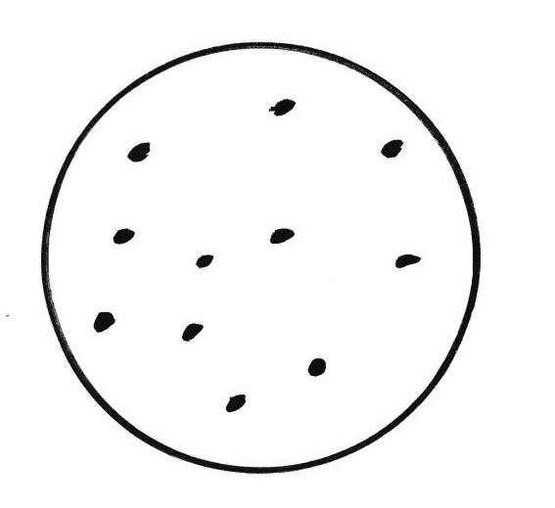
Abstraction of the nuclear structure

Slide 6
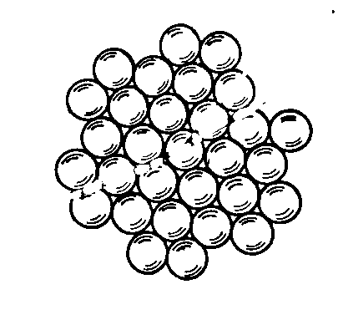
Nuclear structure in the physical reality

Slide 7
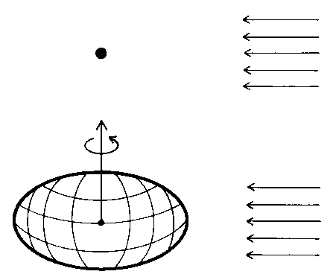

Slide 8
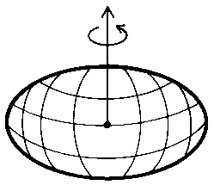

Slide 11

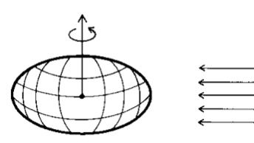

Slide 15
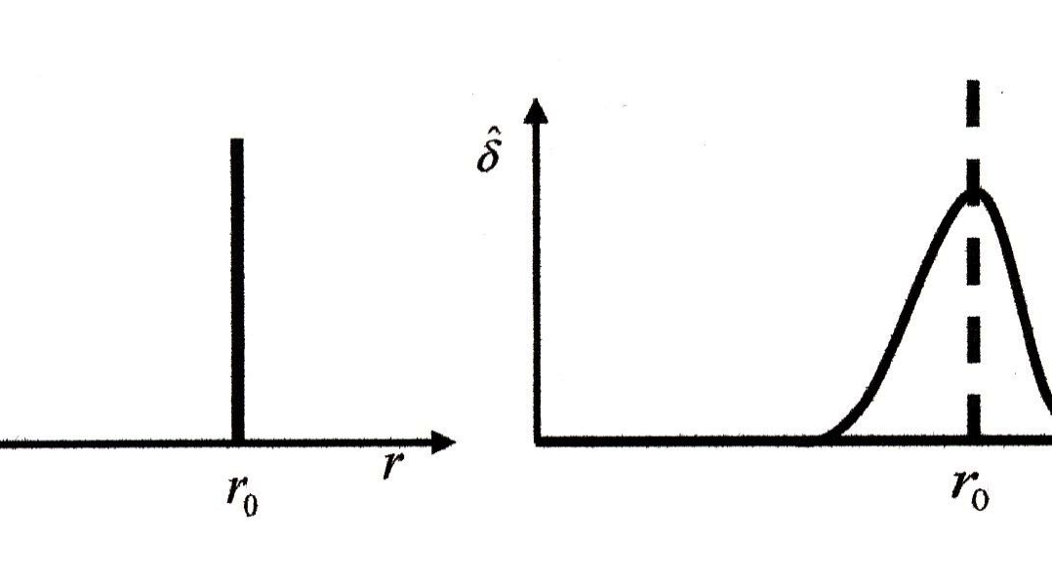


Slide 17
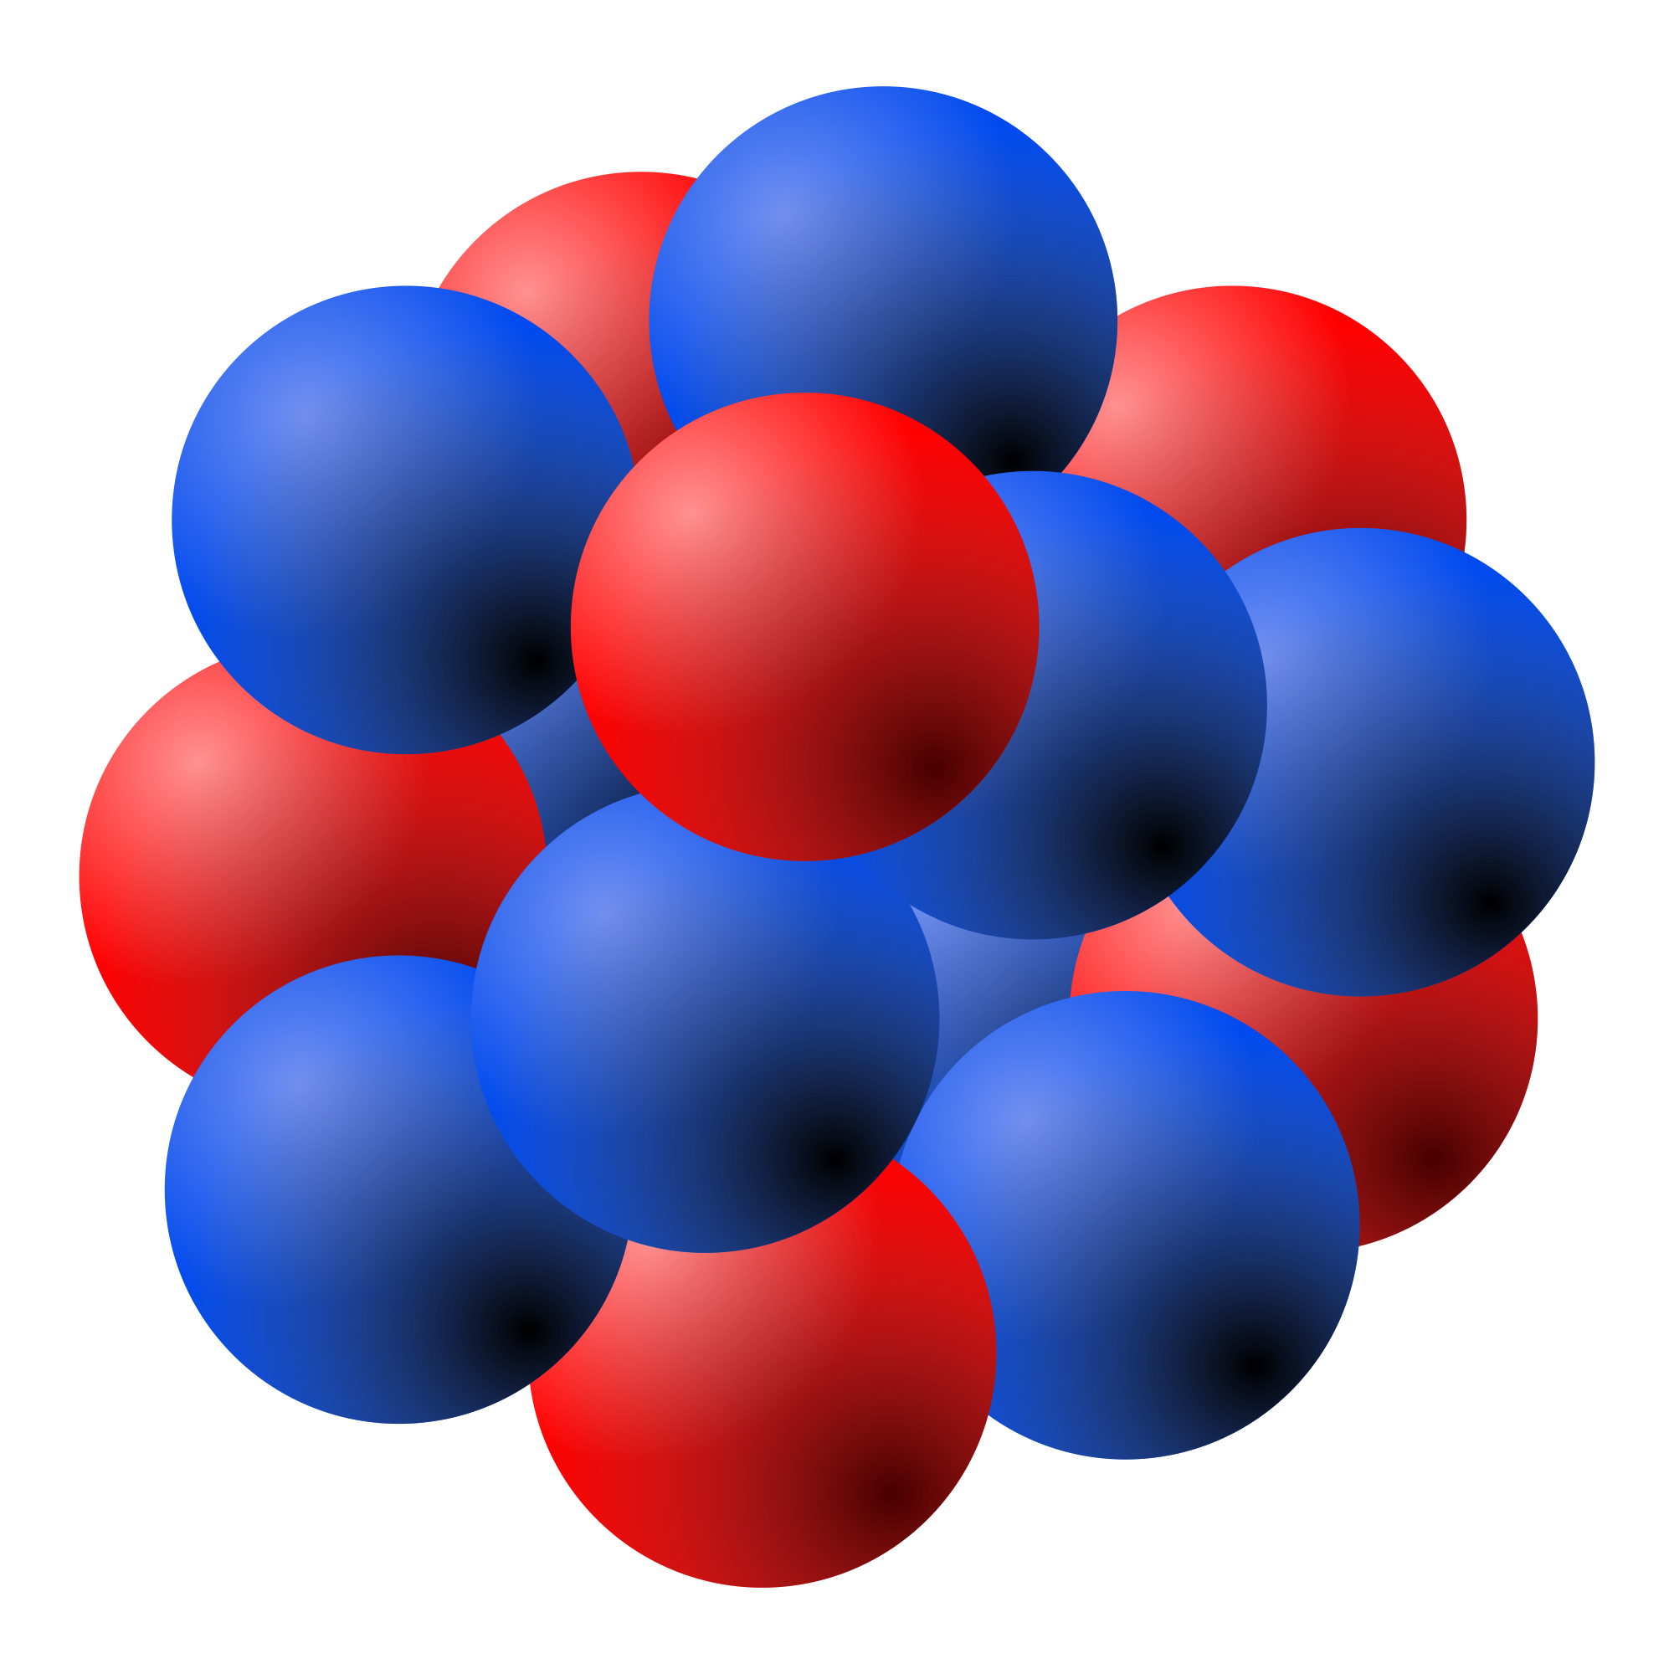
Applications in nuclear physics

Slide 18
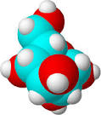
Applications in chemistry

Slide 19

Applications in biology

Slide 20
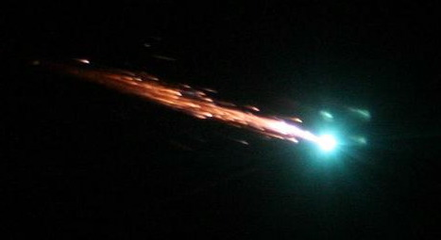
The evident irreversibility of nature

Slide 21
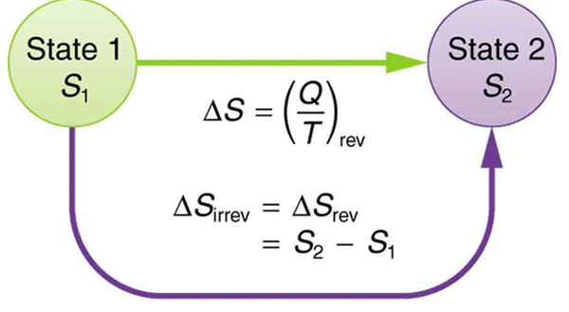

Slide 27
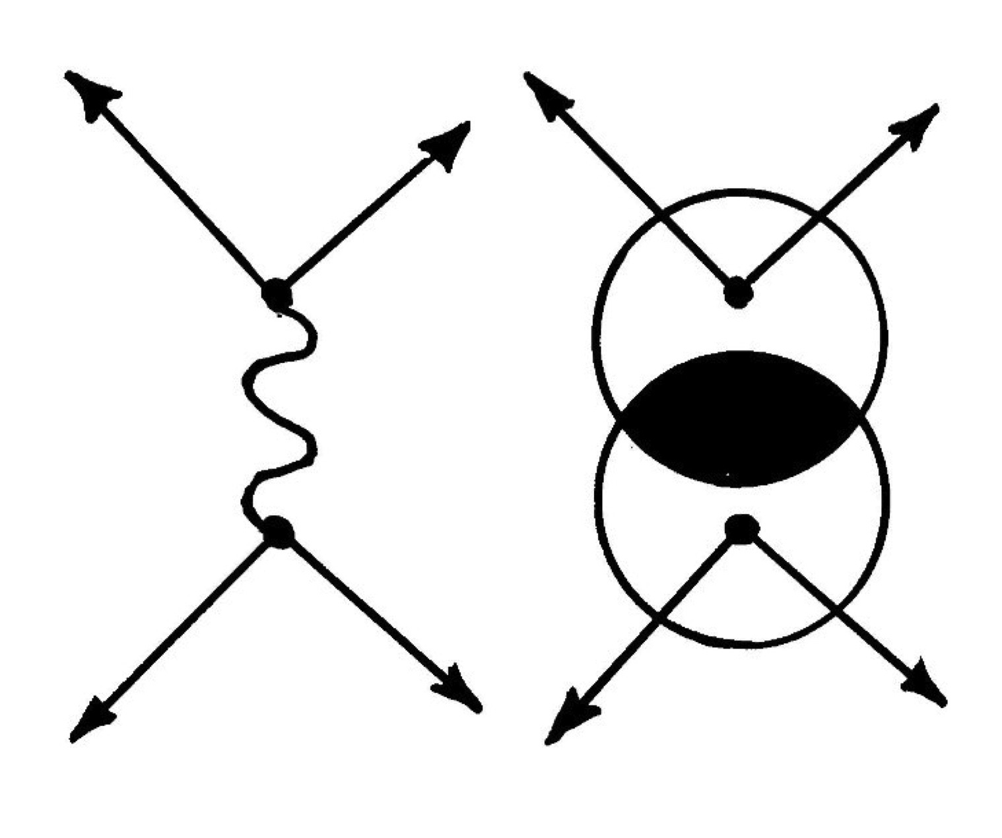
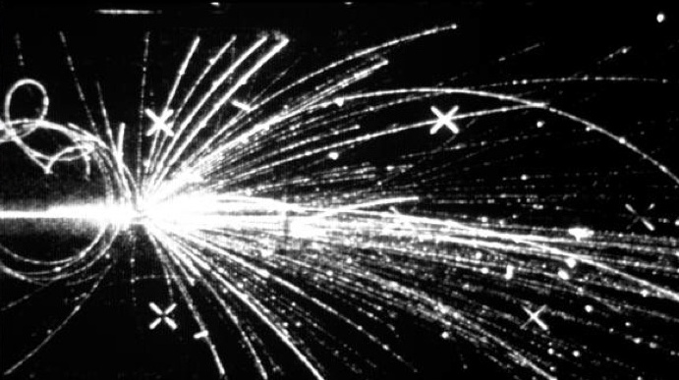

Slide 29
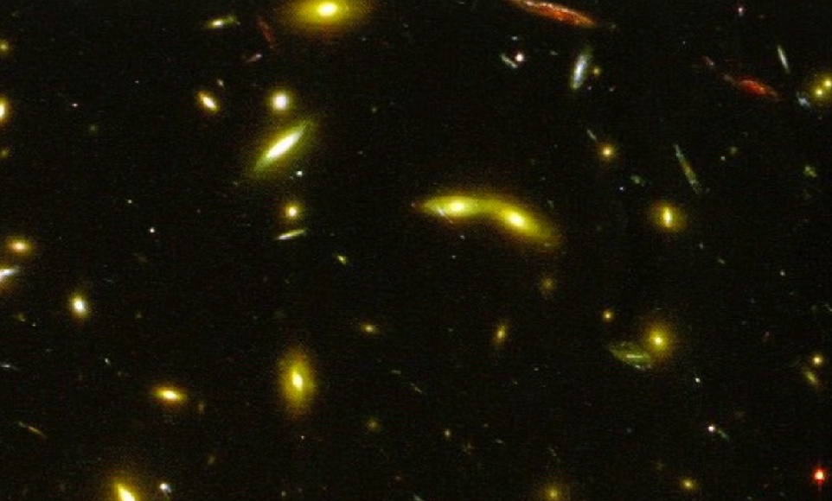
1965 aim: study antimatter galaxies

Slide 30
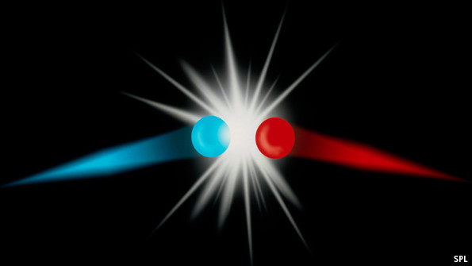
Matter-antimatter annihilation

Slide 35
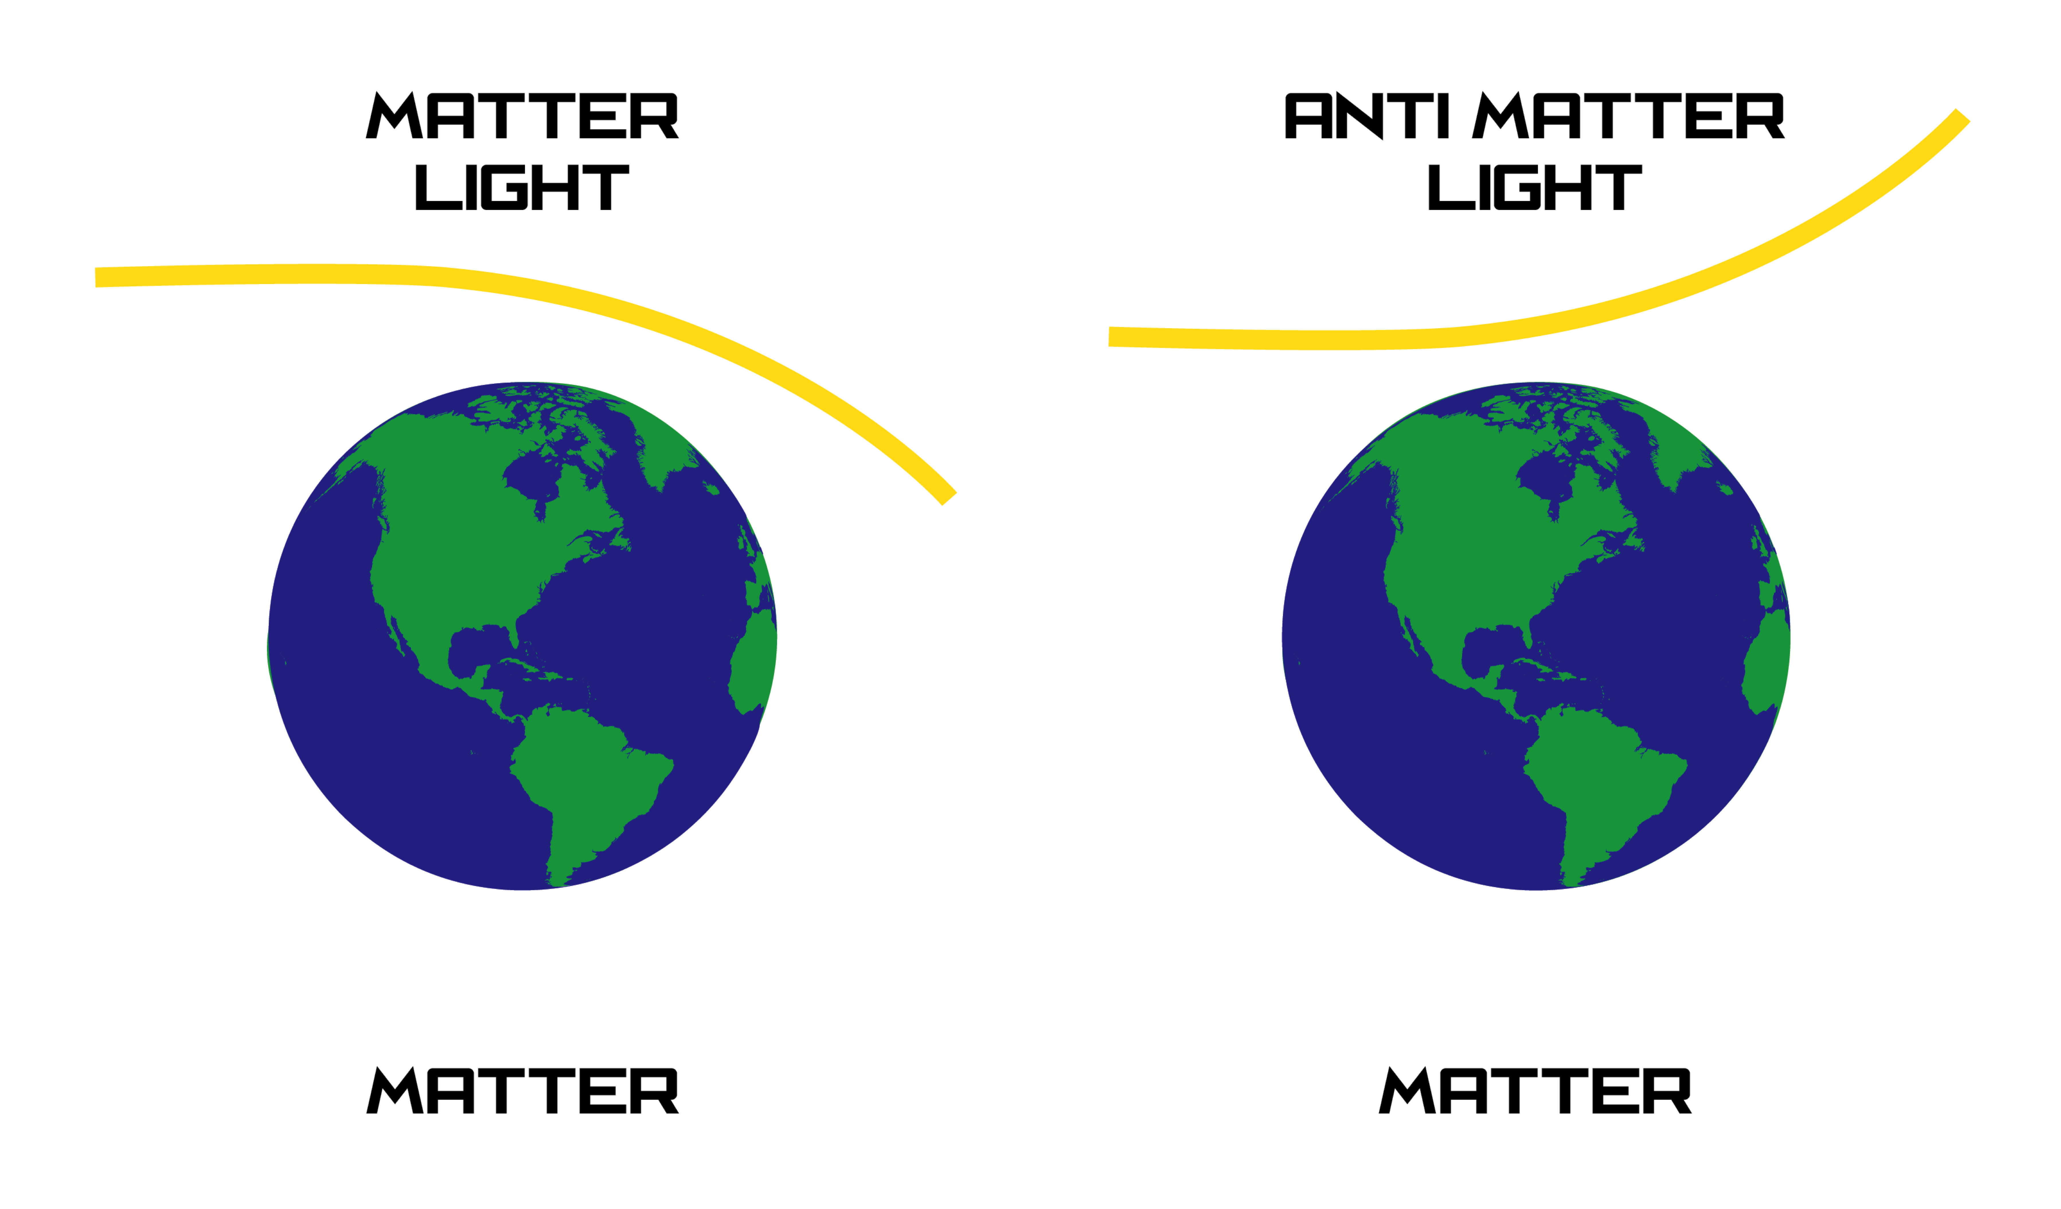
Implications

Slide 36
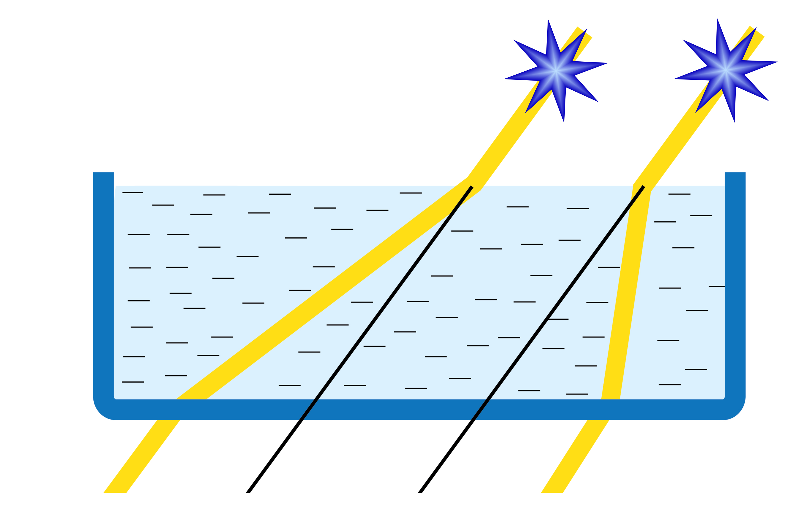

Slide 37
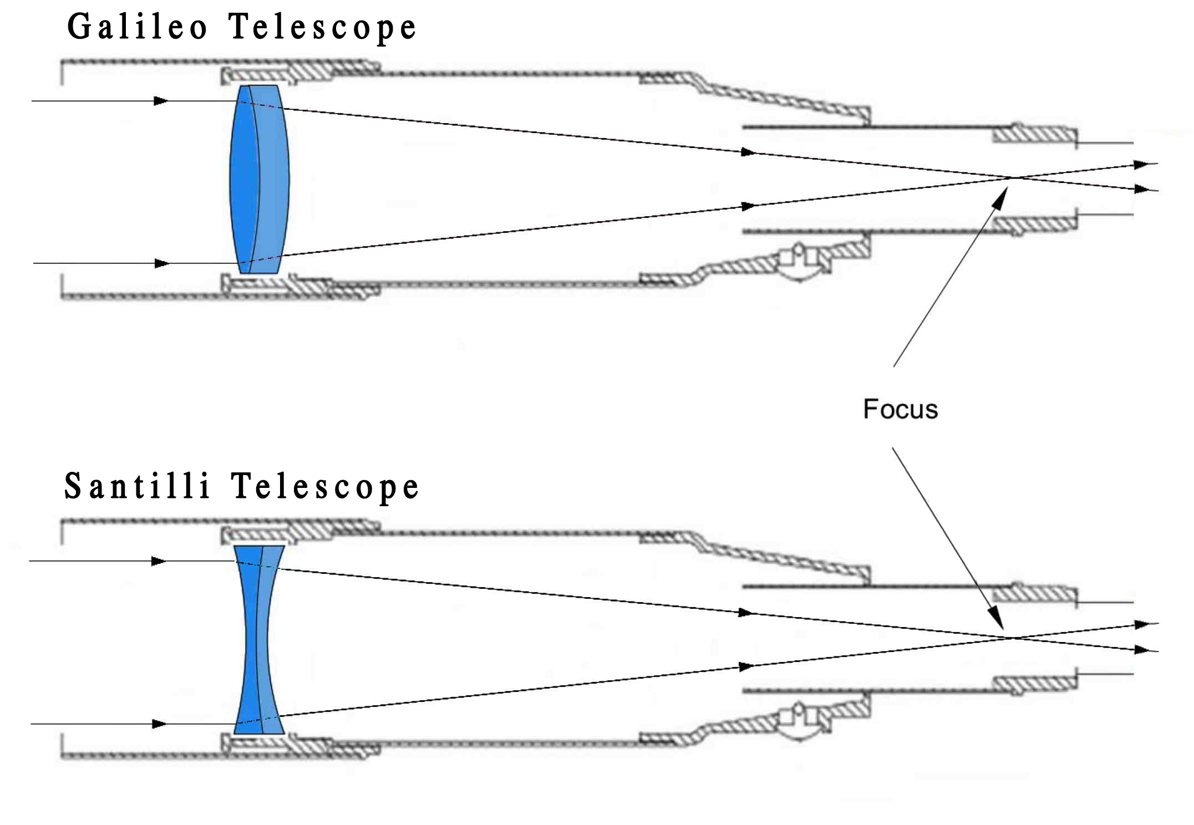

Slide 38
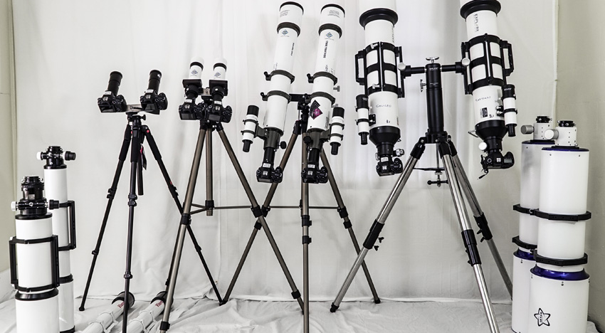
Thunder Energies Corporation
Publicly traded company with stock symbol TNRG

Slide 39
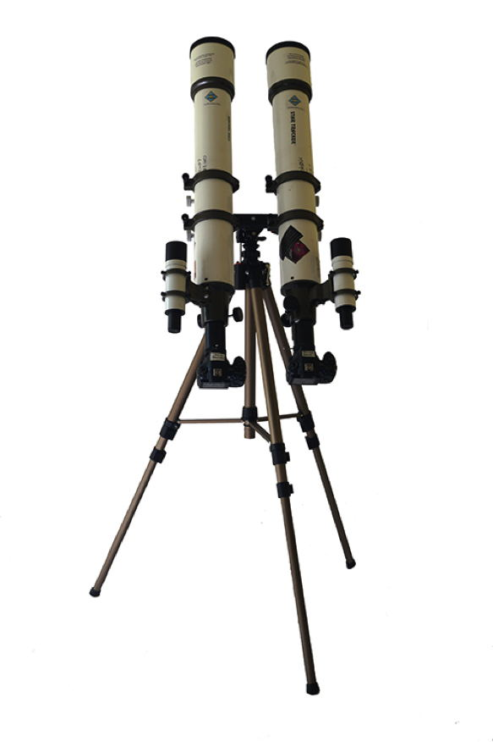

Slide 40
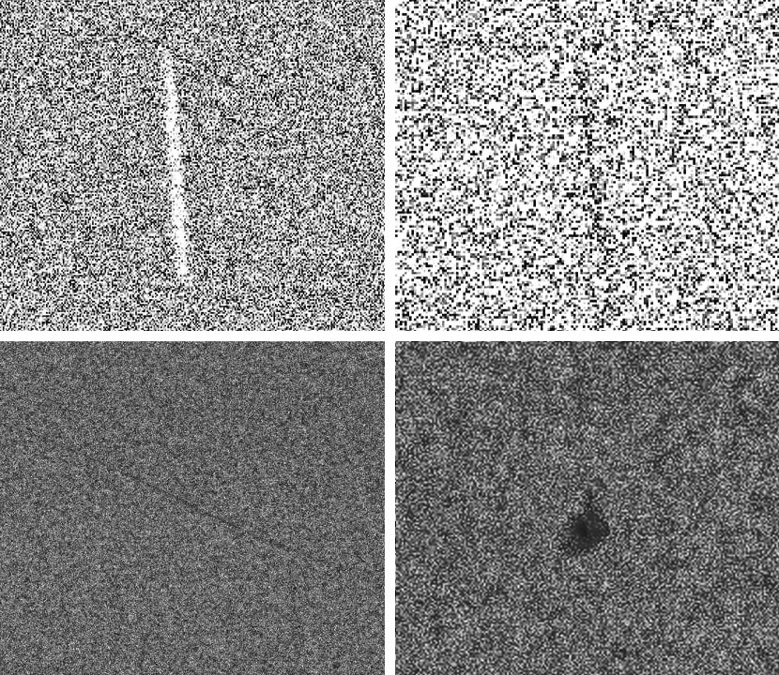
A streak from Vega and apparent streaks from an antimatter galaxy, antimatter asteroids and antimatter cosmic rays

Slide 42
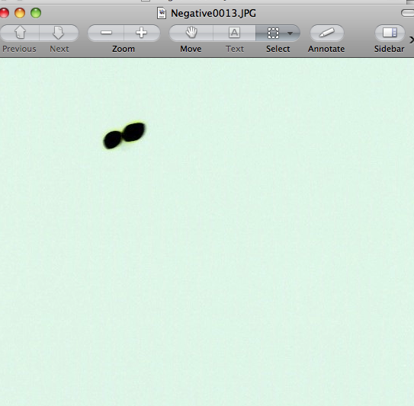
Detections in the Capella region

Slide 43
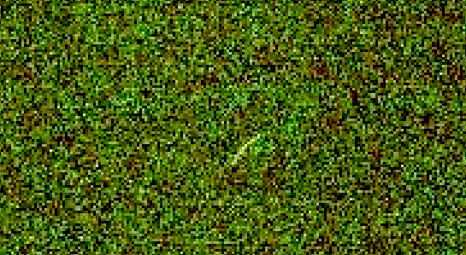
“Rak Antimatter Galaxy”

Slide 44
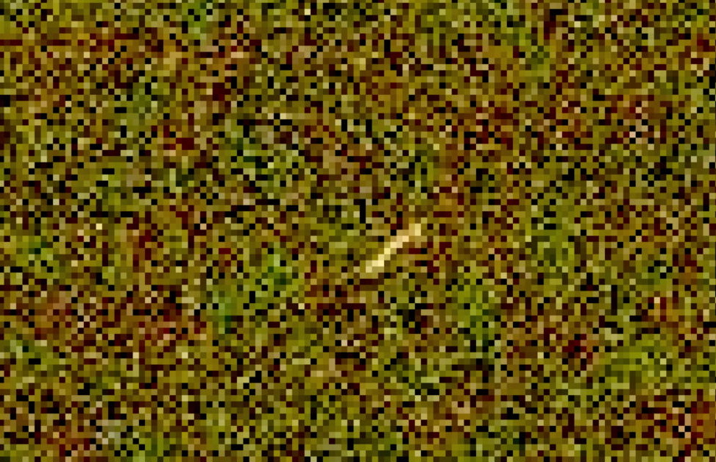
“Rak Antimatter Galaxy”

