Slide 2
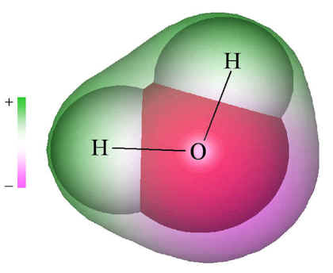
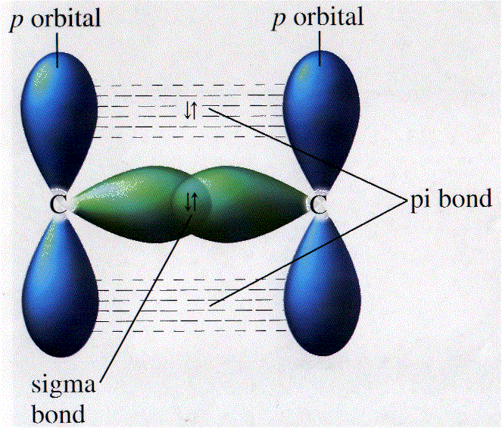
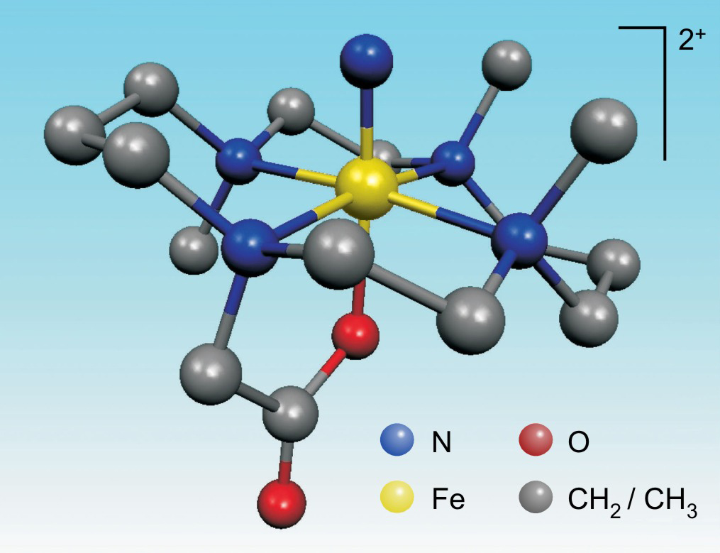
The 20th century notion of valence bond is a "nomenclature" because it lacks a "quantitative" representation of the "attractive" force between identical electrons.

Slide 3
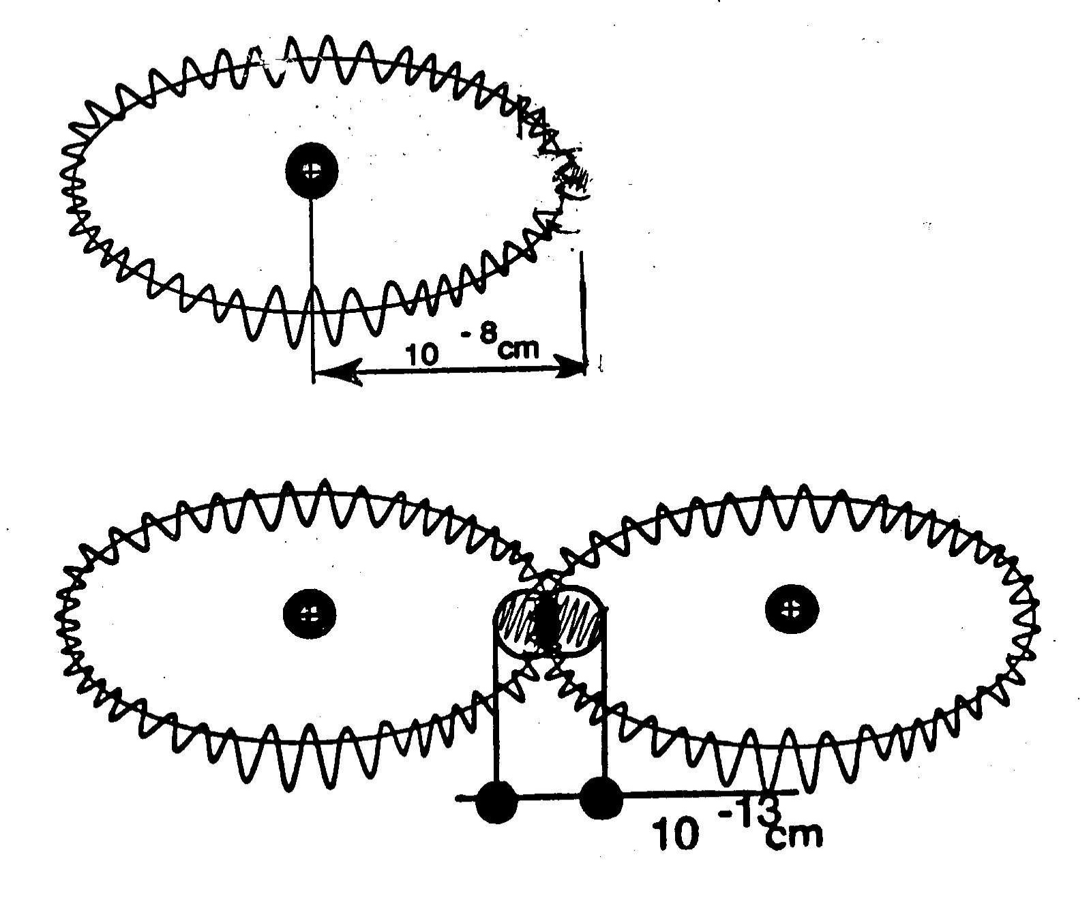
Quantum mechanics has an incredible exact validity for the numerical representation of the structure of ONE hydrogen atom., but it is merely approximately valid for TWO hydrogen atoms bonded into the H2 molecule.

Slide 5
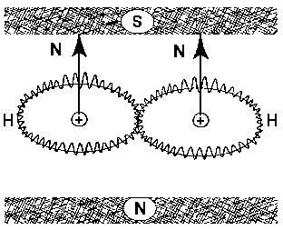
It has been proved by one of my graduate students that, under the current notion of valence, all substances are paramagnetic - in dramatic disagreement with nature - because tall 20th century orbitals can be oriented under a sufficiently strong magnetic field.

Slide 6
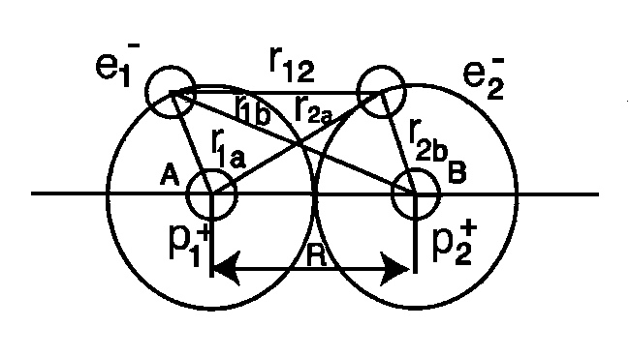
It is easy to prove that two hydrogen atoms have an identically NULL mutual force in the event all acting forces are of electromagnetic nature.

Slide 7
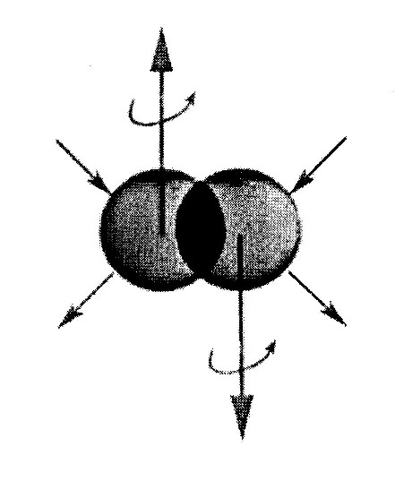
The interactions of two identical valence electrons in singlet couplings are non-linear, non-local and non-Hamiltonian, thus being beyond any dream of representation via the axioms of quantum mechanics and chemistry due to structural insufficiencies of their mathematics.

Slide 11
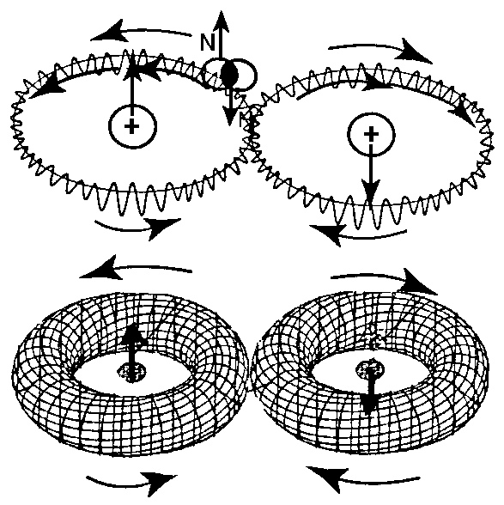

Slide 12
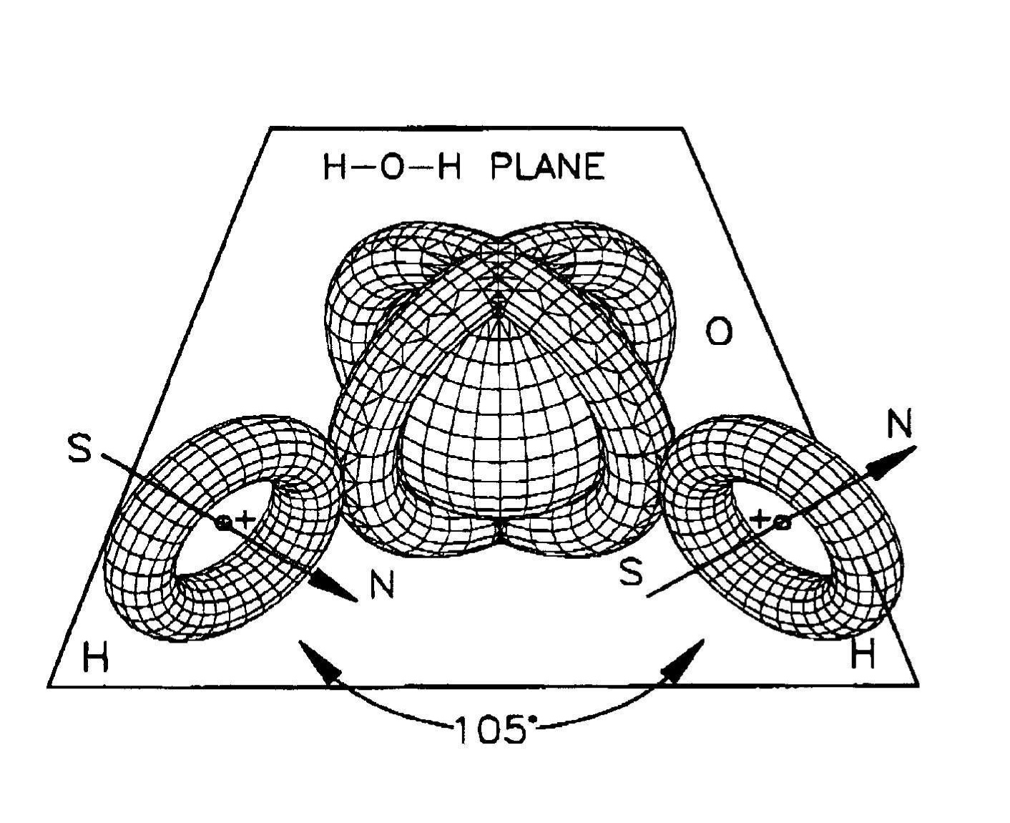

Slide 13
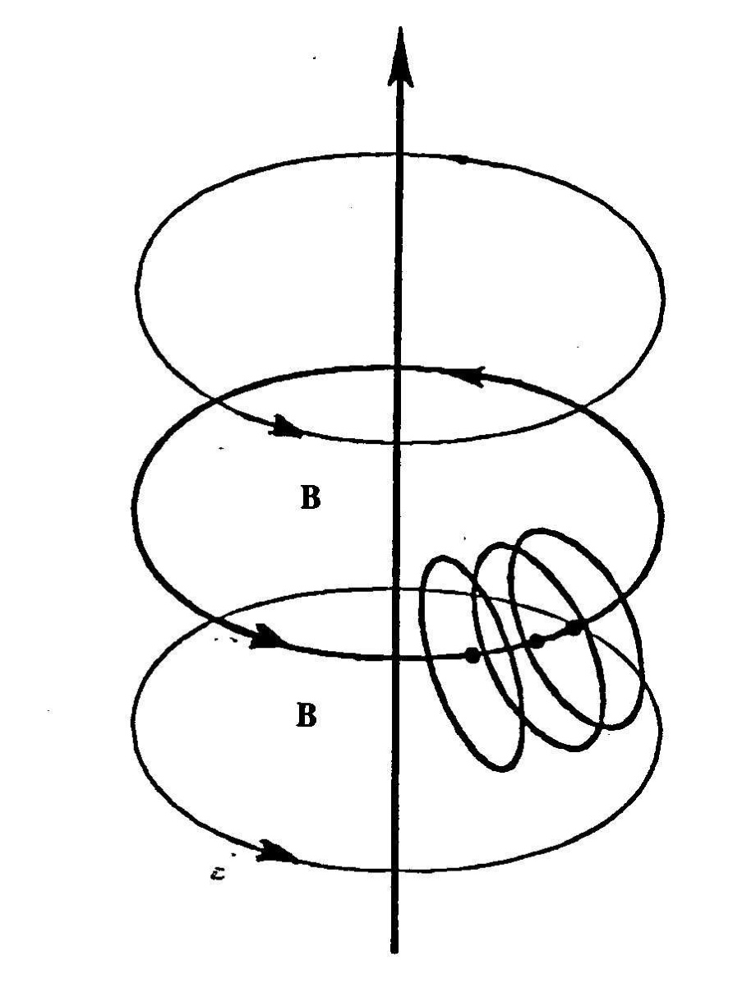
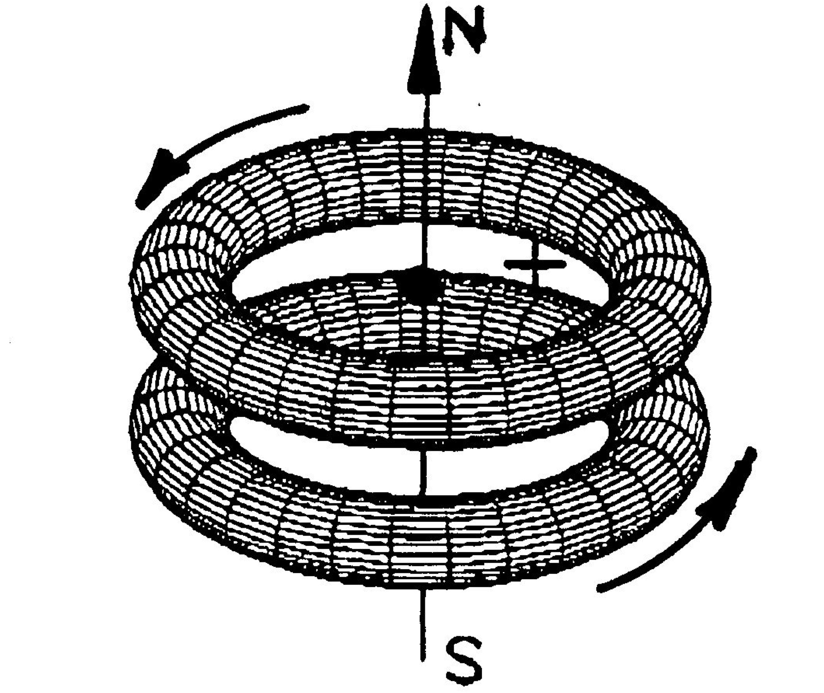

Slide 14
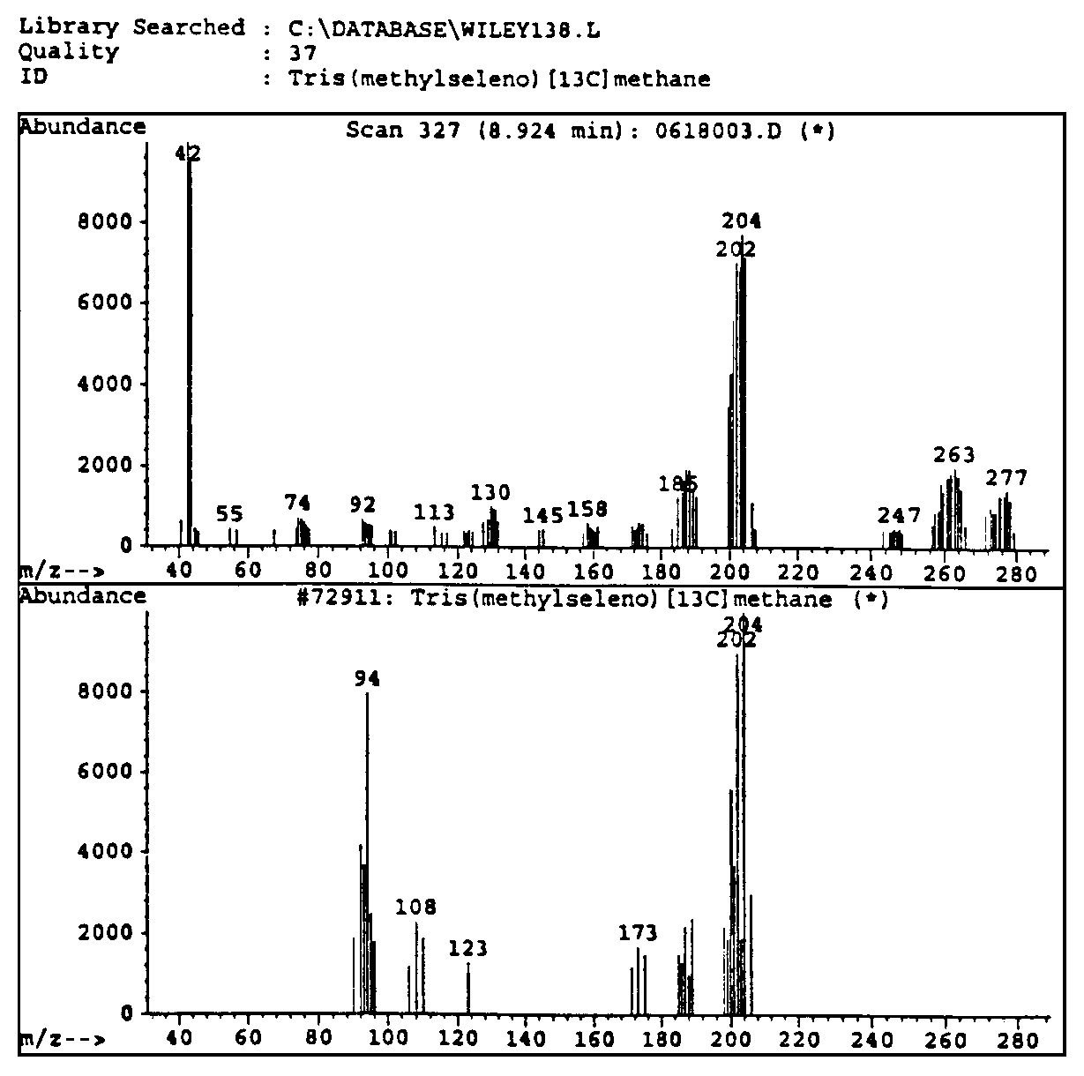
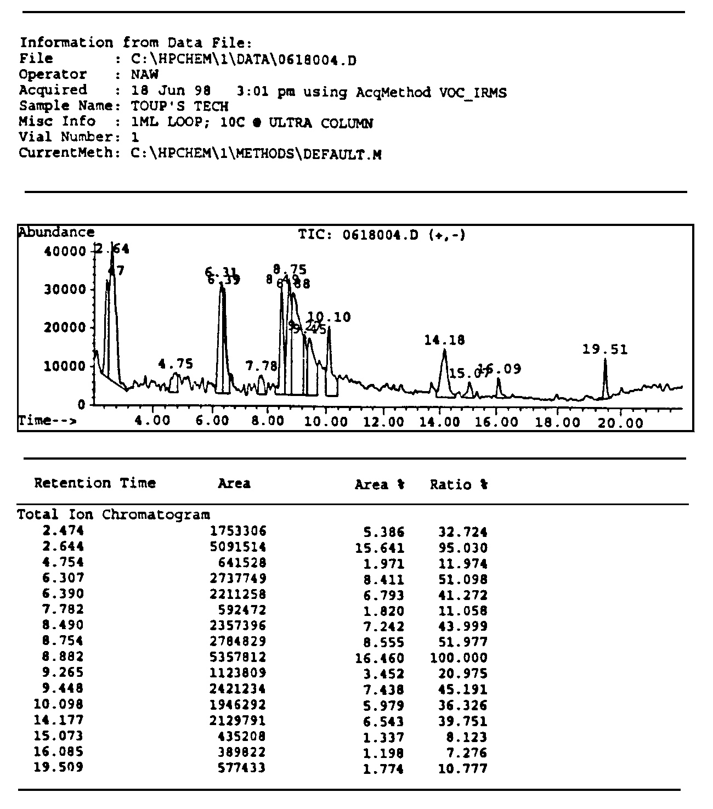
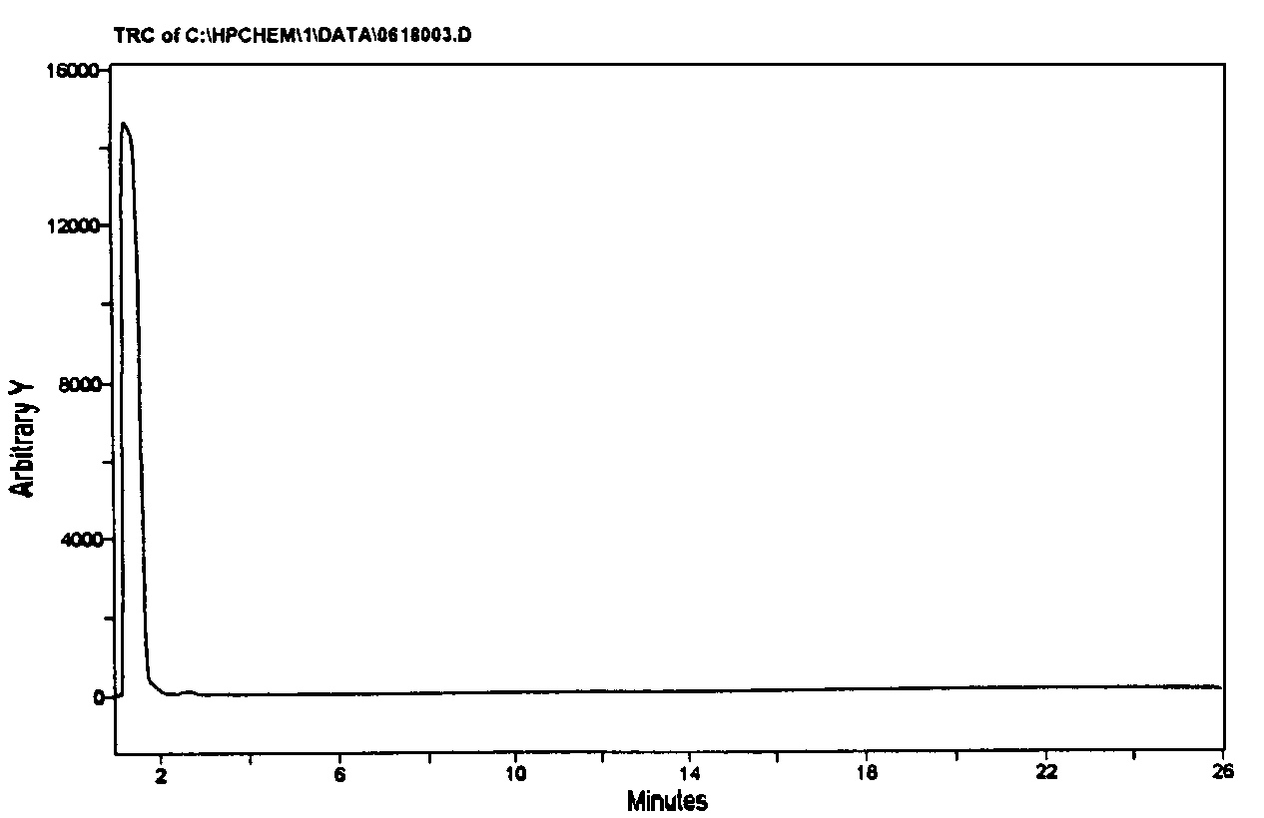
The original 1998 detection still valid today

Slide 15
2012 confirmations of the new chemical species of magnecules done at the analytic laboratory of Magnegas Corporation with 1999 reconditioned HP GC 5890, HP MS 5972 and HP IRD 5969

Slide 16
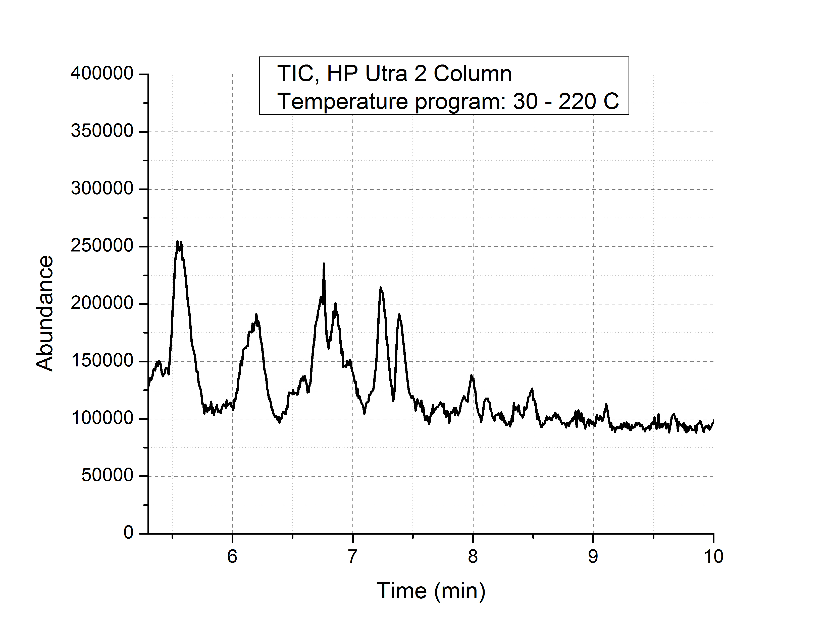

Slide 17
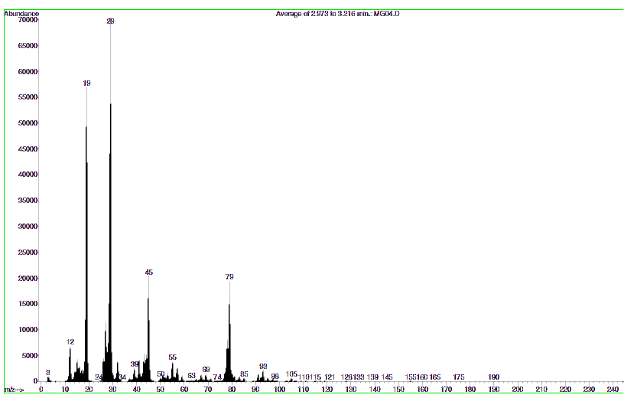
The novel species of H3O = H-O-HxH, COH = C-OxH, CO2H =O- C-OxH, etc.

Slide 18
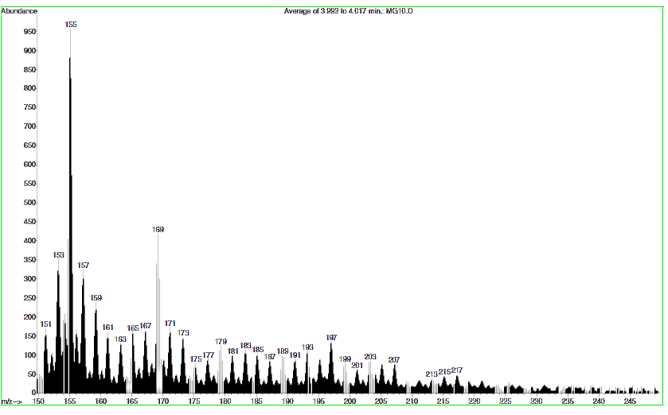
Hydrogen accretion 165, 166, 167, 168, 169, 170, 171, 172, 173,…

Slide 19
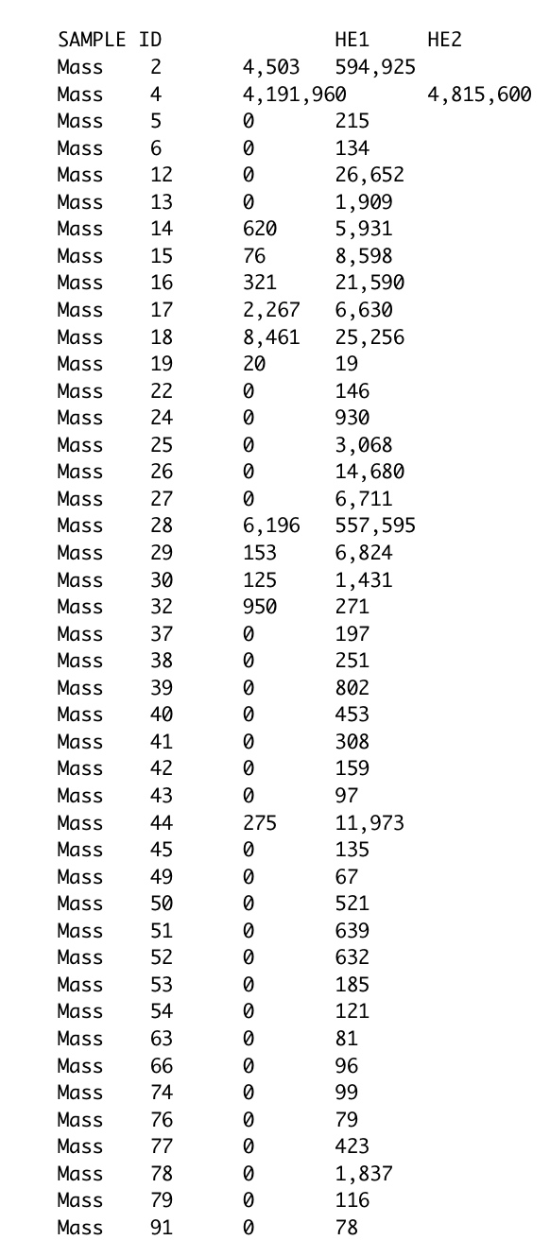
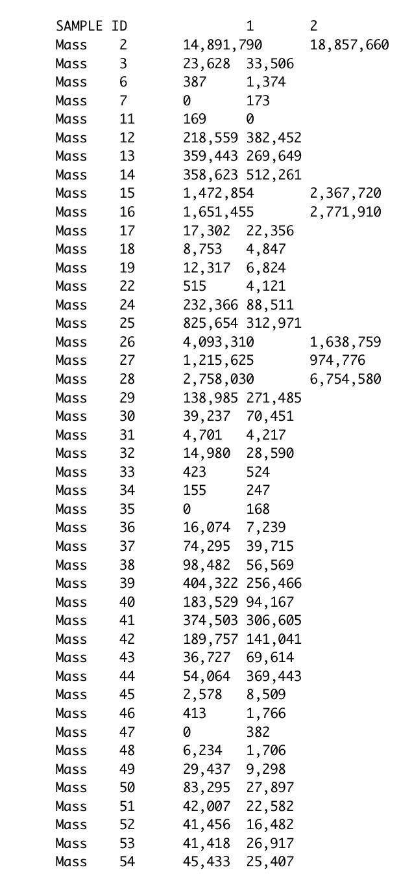
One of the many chemical analyses of MagneGas conducted at ONEIDA Analytic Laboratories of Whitesboro, New York, showing the series of anomalous species 3 amu, 4 amu, 5 amu, 6 amu, 7 amu, 8 amu, 9 amu, etc.

Slide 20
Magnecular interpretation

Slide 21
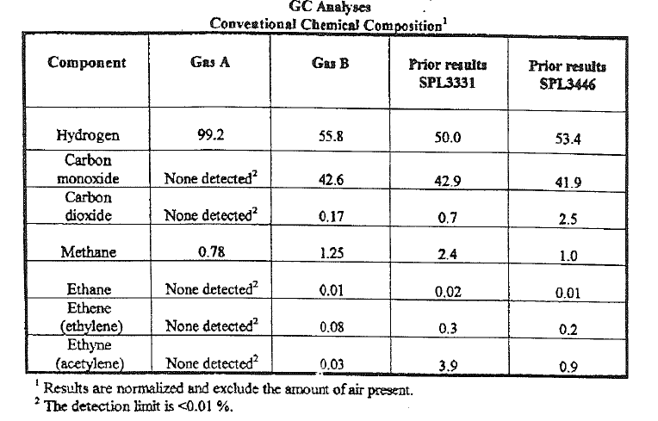

Slide 22
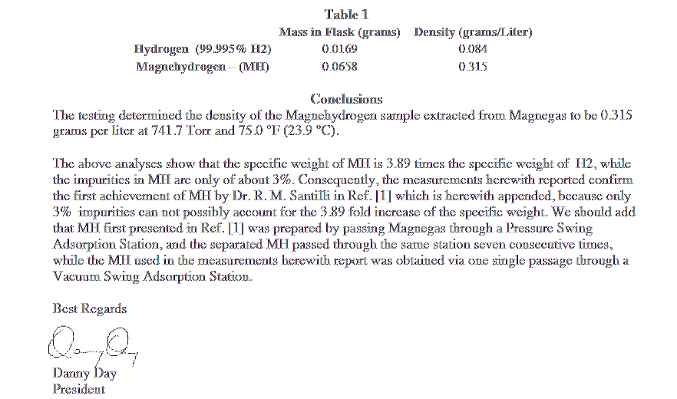
Confirmation of MagneHydrogen by Eprida Laboratories of Atlanta in 2011

Slide 23
The Vacuum Swing Adsorption Pilot Station for the production of MagneHydrogen at Magnegas Corporation

Slide 24
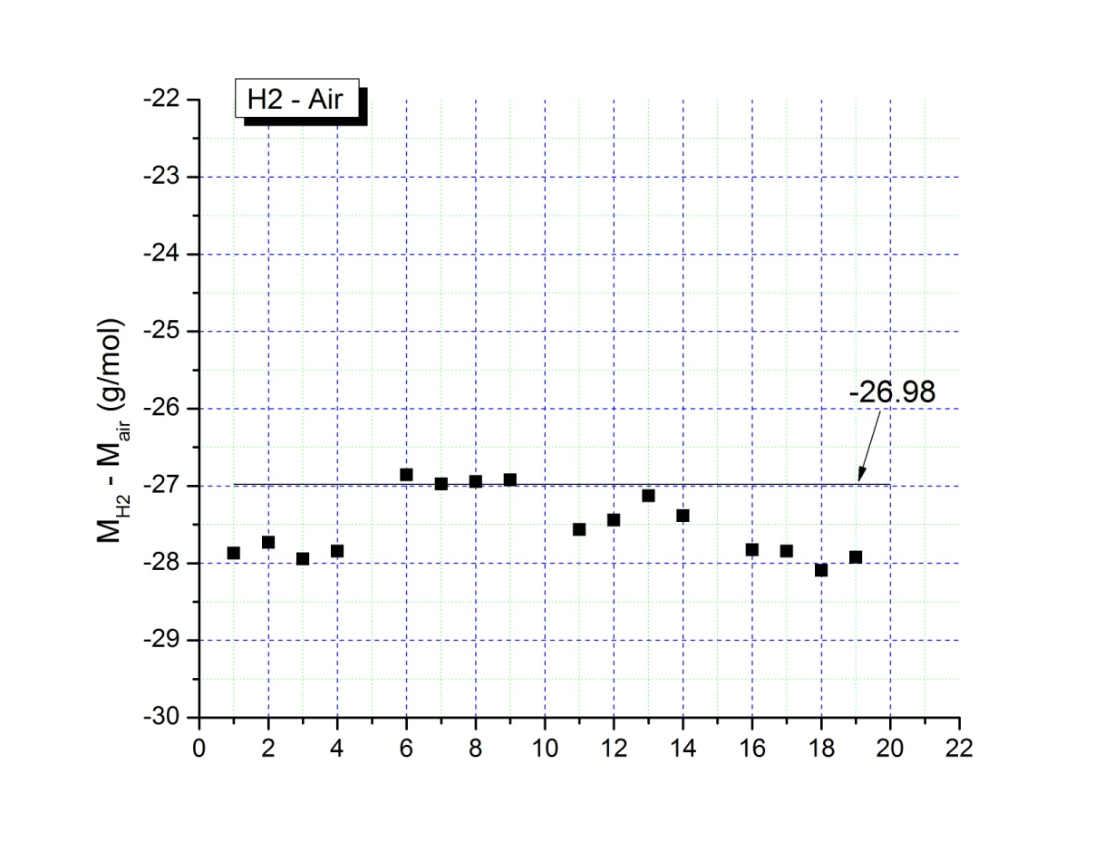
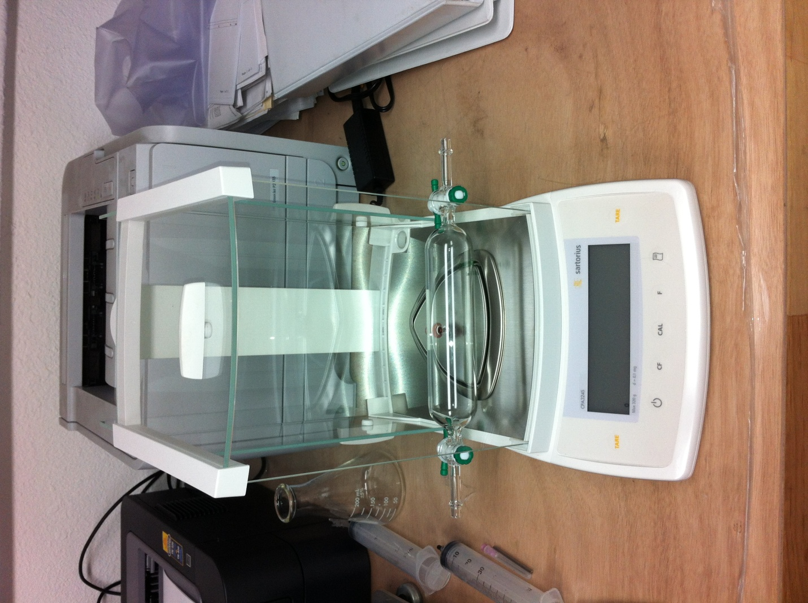
Calibration for measuring the specific weight of MagneHydrogen
H2air
15 psi-0.3018-27.8709
-0.3003-27.7323
-0.3026-27.9447
-0.3015-27.8432
10 psi
-0.2439-26.8554
-0.245-26.9765
-0.2447-26.9435
-0.2445-26.9215
H2air
5 psi
-0.2022-27.5648
-0.2013-27.4421
-0.199-27.1286
-0.2009-27.3876
0 psi
-0.1458-27.8265
-0.1459-27.8456
-0.1472-28.0937

Slide 25
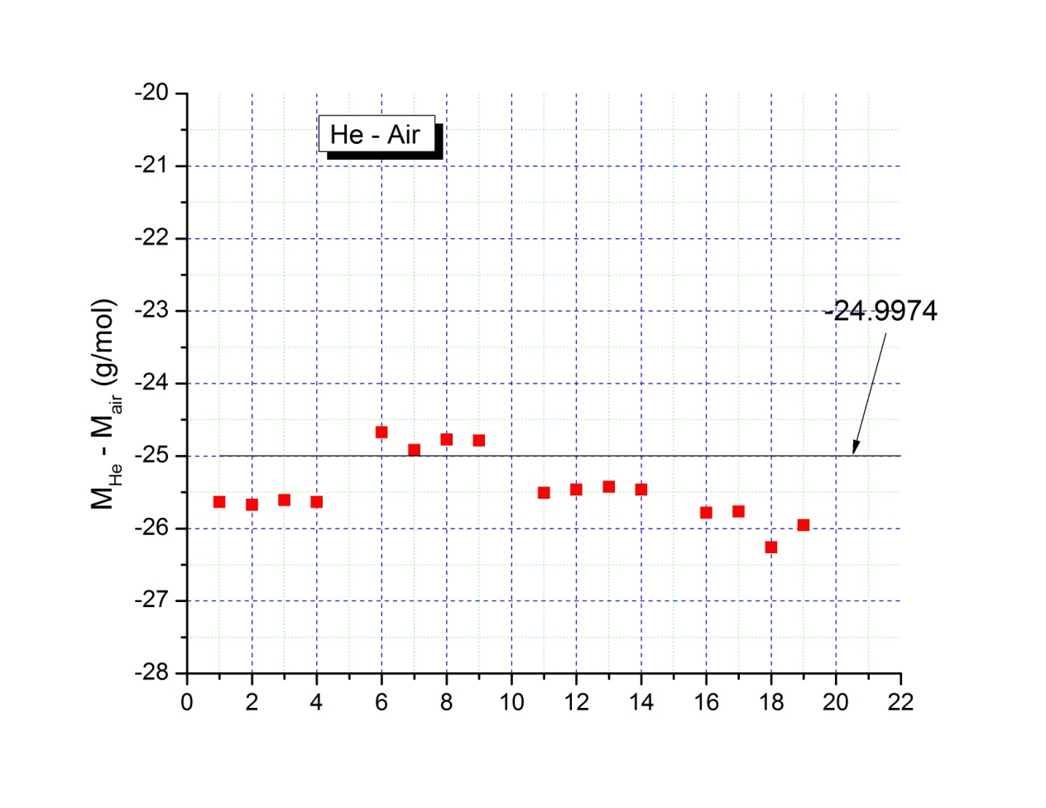
Heair
15 psi-0.2776-25.636
-0.278-25.673
-0.2773-25.6083
-0.2776-25.636
10 psi
-0.2241-24.6752
-0.2263-24.9175
-0.225-24.7743
-0.2251-24.7854
Heair
5 psi
-0.1871-25.5063
-0.1868-25.4654
-0.1865-25.4245
-0.1868-25.4654
0 psi
-0.1351-25.7844
-0.135-25.7653
-0.1376-26.2615
-0.136-25.9562

Slide 26
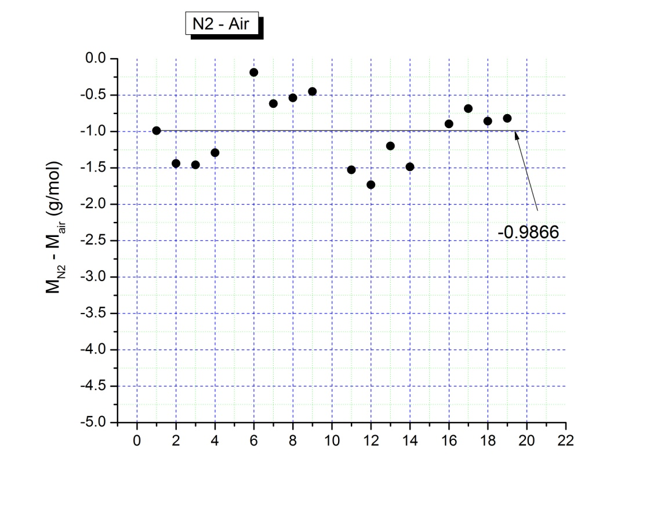
N2air
15 psi-0.0107-0.98813
-0.0156-1.44064
-0.0158-1.45911
-0.014-1.29288
10 psi
-0.0017-0.18718
-0.0056-0.61661
-0.0049-0.53953
-0.0041-0.45144
H2air
5 psi
-0.0112-1.52683
-0.0127-1.73132
-0.0088-1.19965
-0.0109-1.48594
0 psi
-0.0047-0.89701
-0.0036-0.68708
-0.0045-0.85884

Slide 27
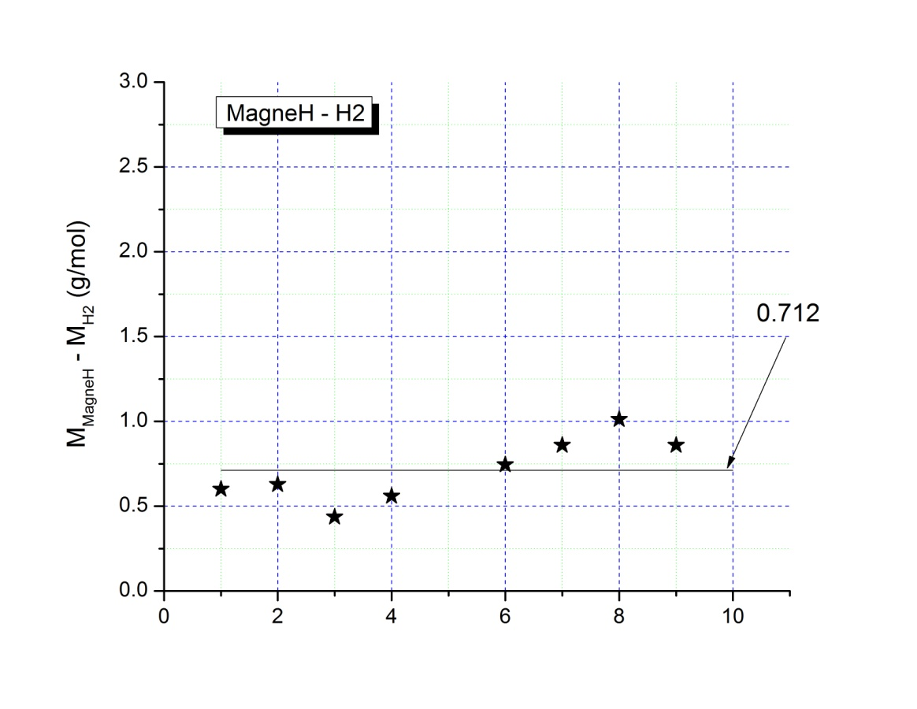
Measurement of the specific weight of one sample of MagneHydrogen yielding an average of 2.71 a.m.u. thus having 35% anomalous weight with hydrogen purity of about 98 %
N2air
5 psi0.00440.599827
0.00460.627092
0.00320.436238
0.00410.55893
0 psi
0.00390.744331
0.00450.858844
0.00531.011527
0.00450.858844

Slide 30
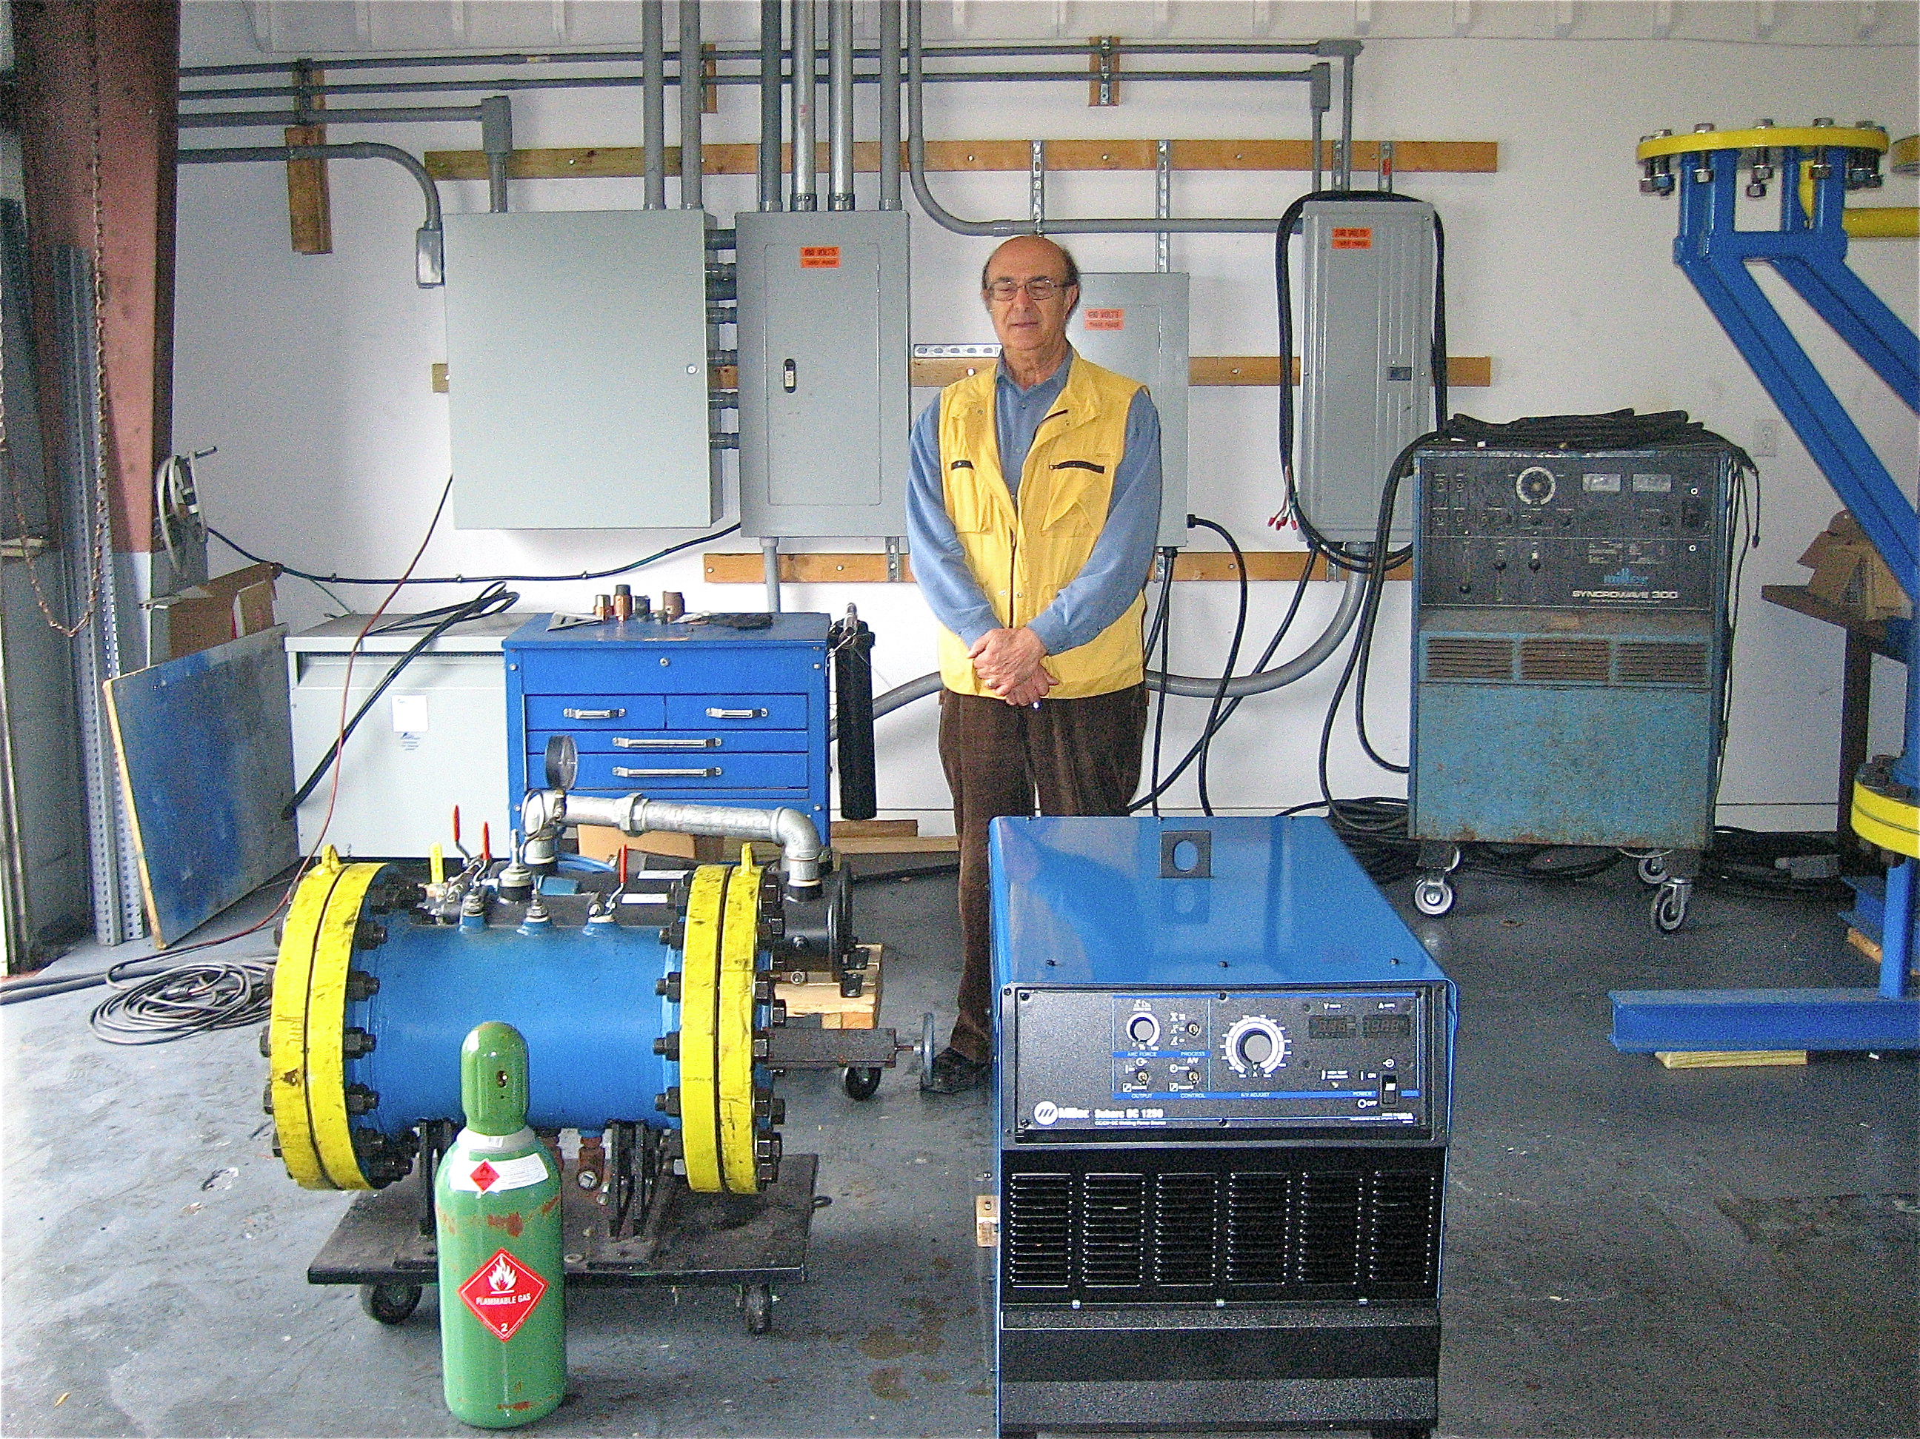
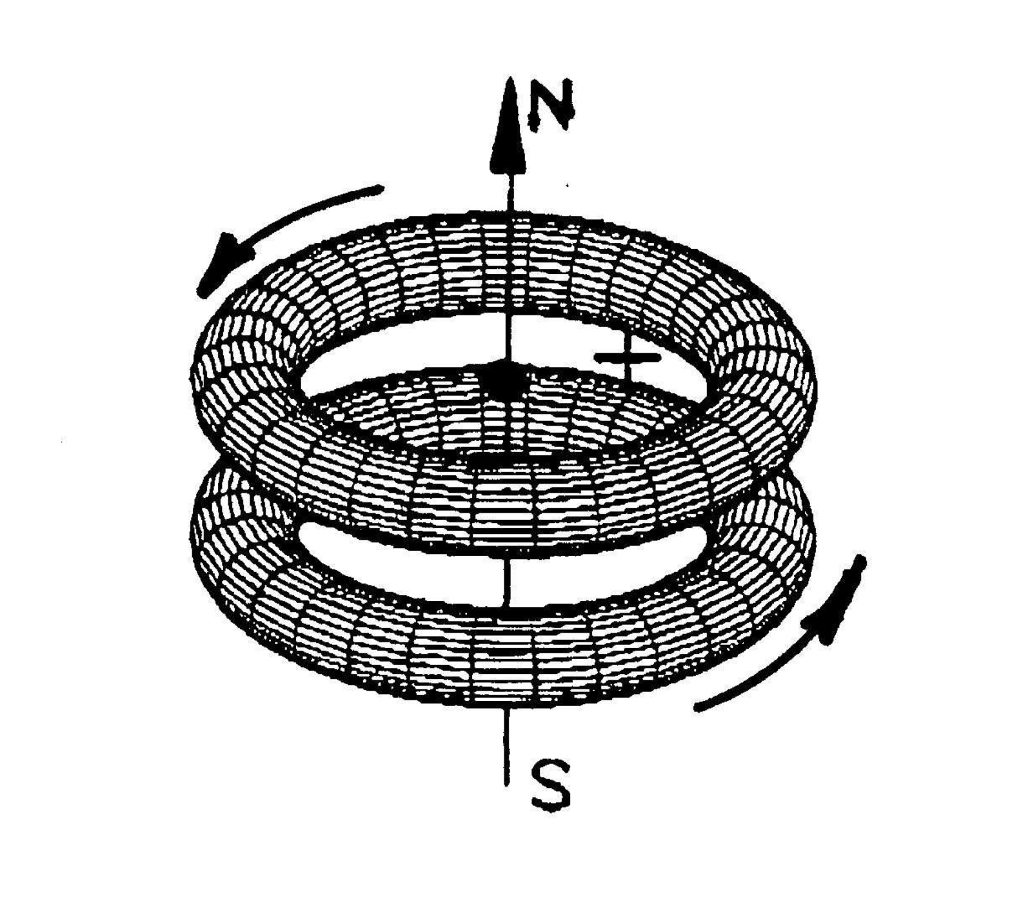
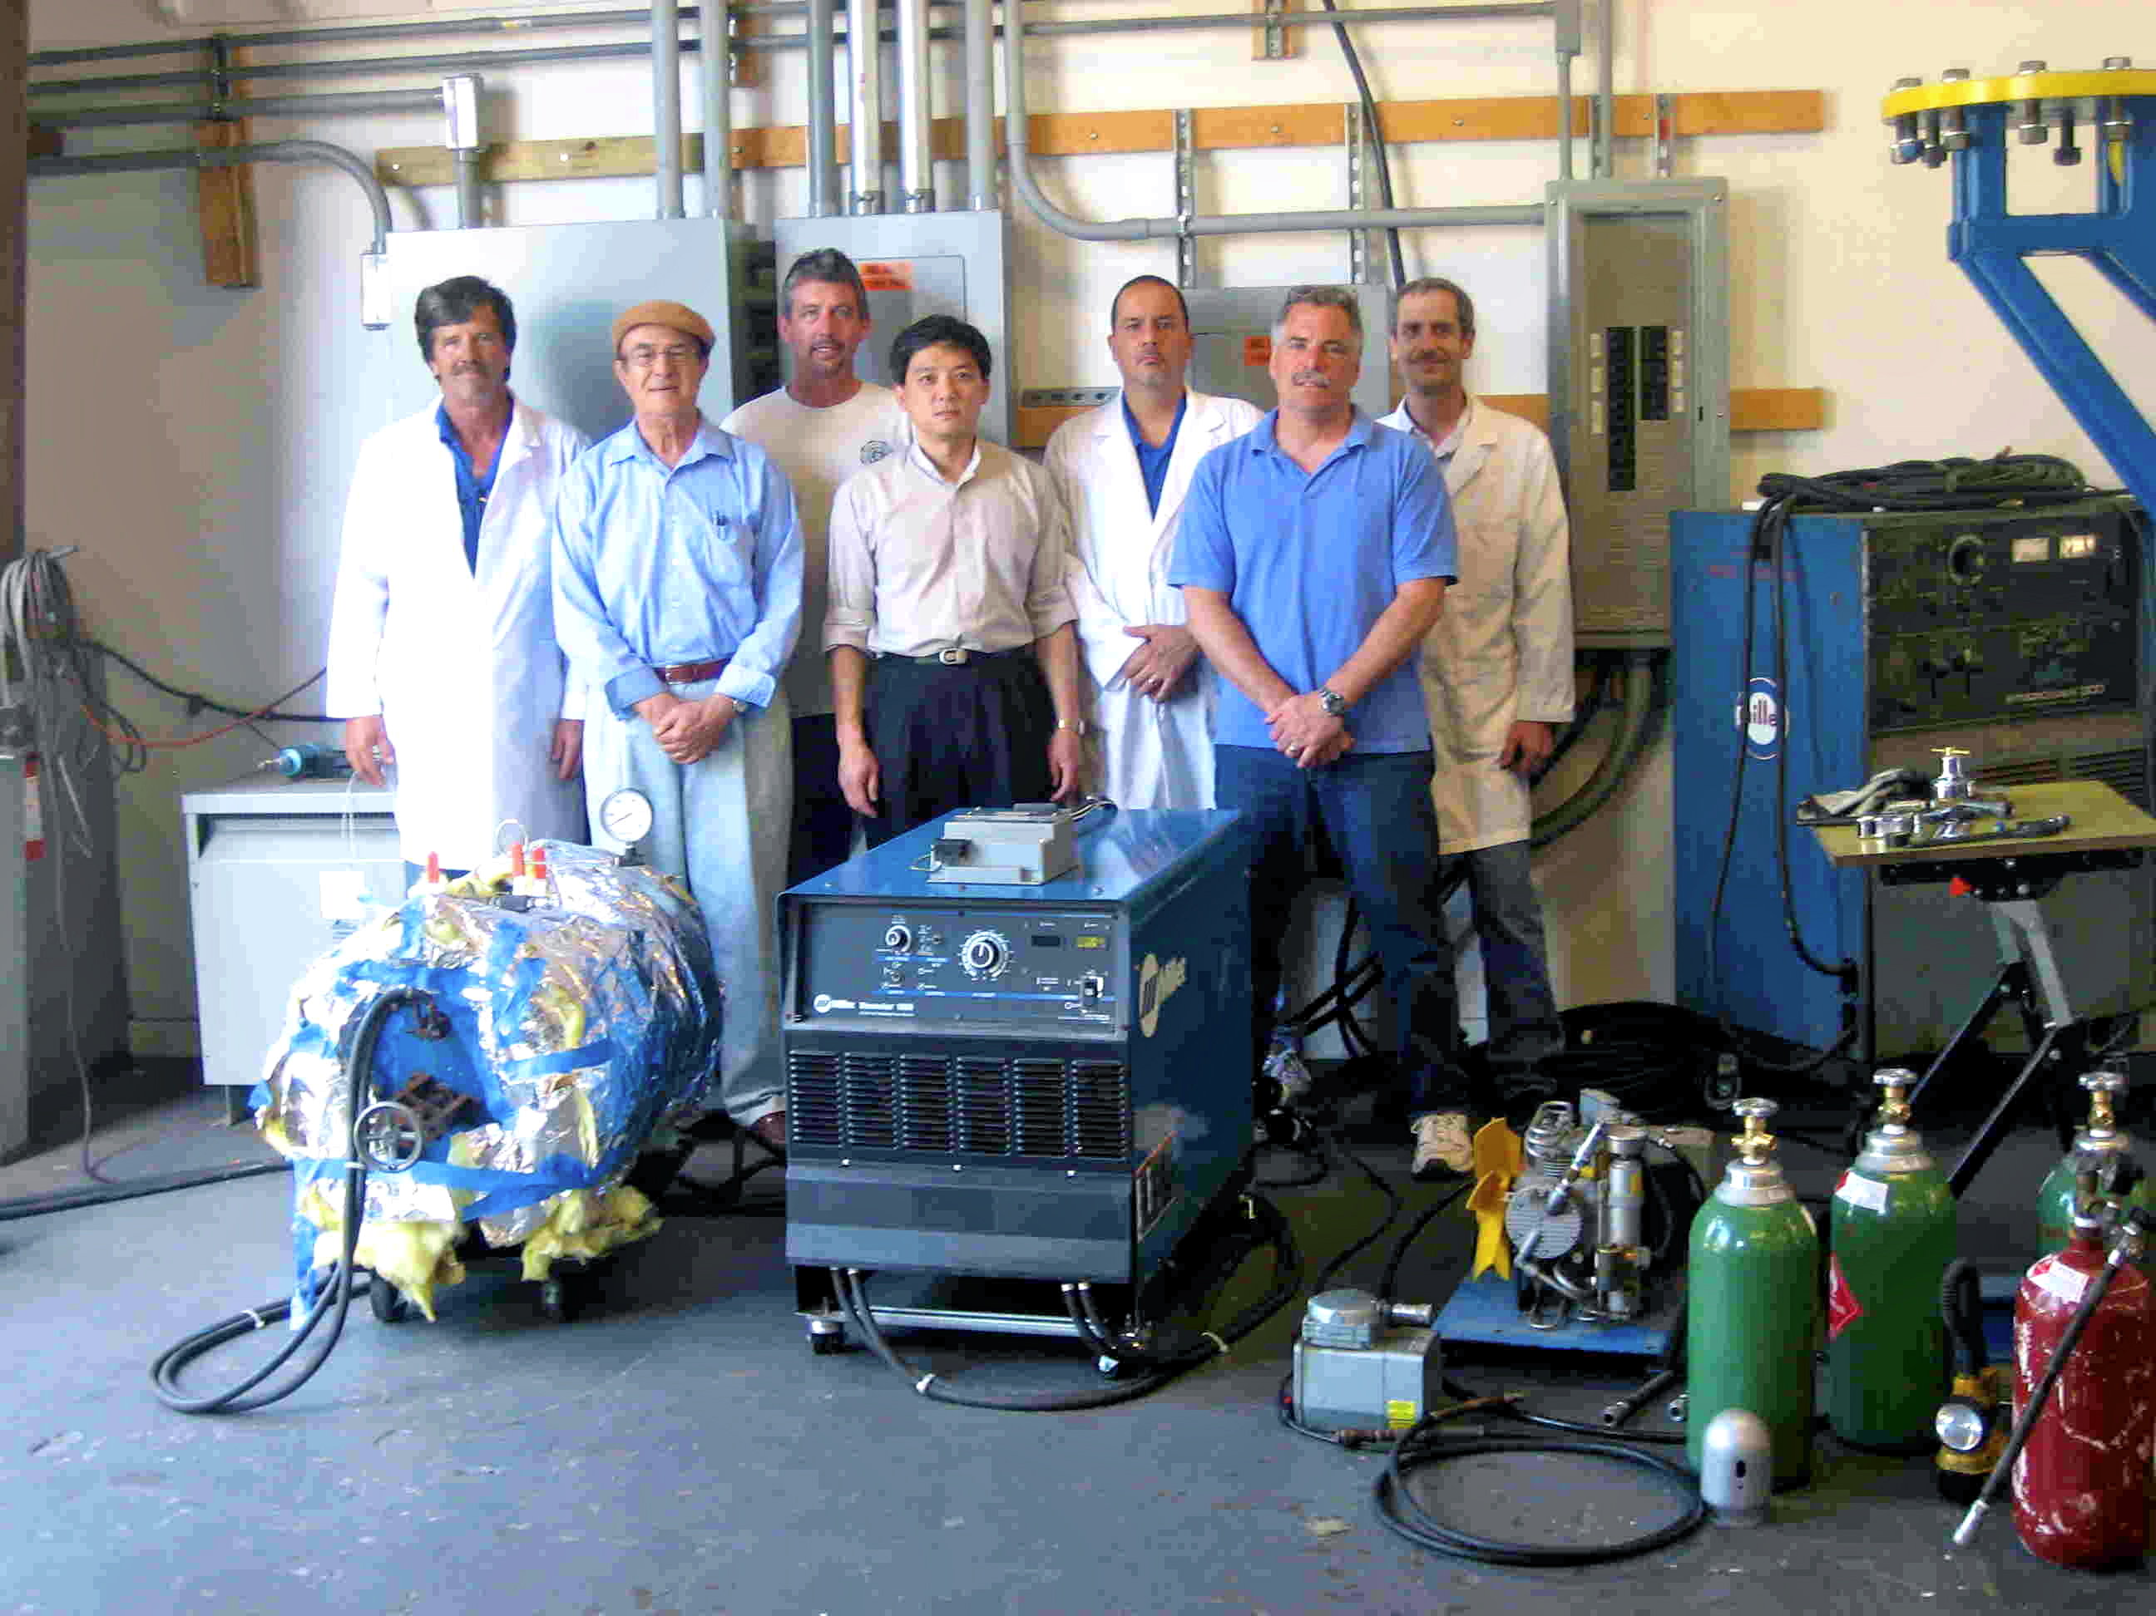
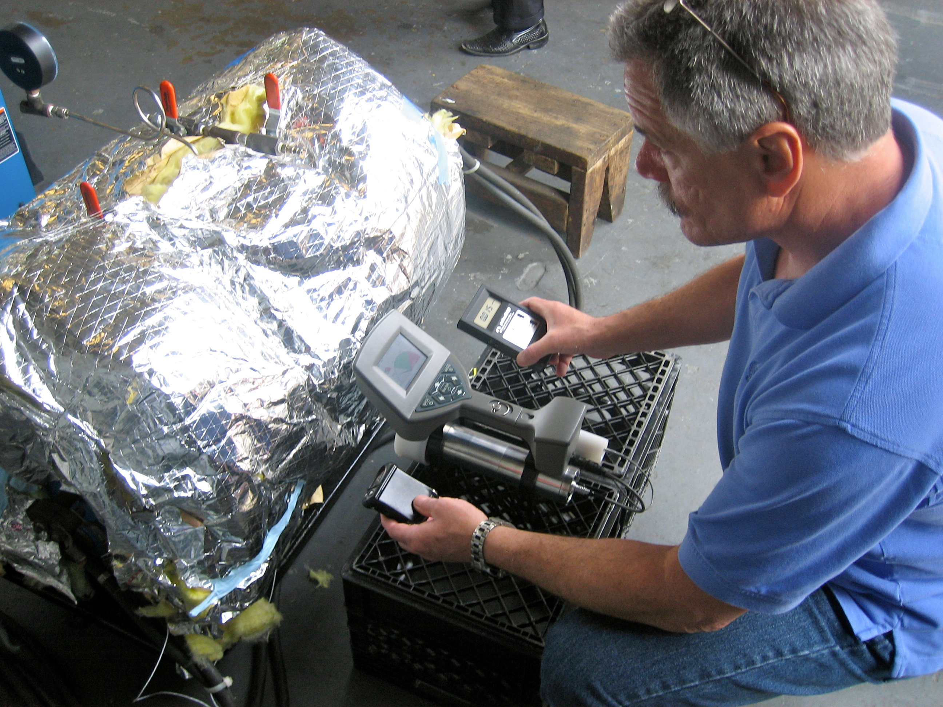

Slide 31
Research Project # 1: From the species H30 can we deduce that the liquid state of water a magnecular structure, 100 C being its Curie Temperature?

Slide 32
Research Project # 2: Establish the bond of the specie H3, H4, H5, H6, etc. whether of valence or not.

Slide 33
Research project # 3: Conduct accurate spectroscopic analysis of the flame of Magnegas and MagneHydrogen in comparison with the Sun spectral lines.

